Slide 1
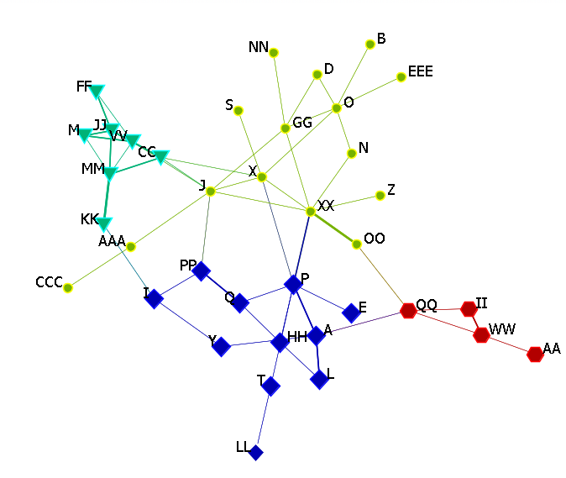
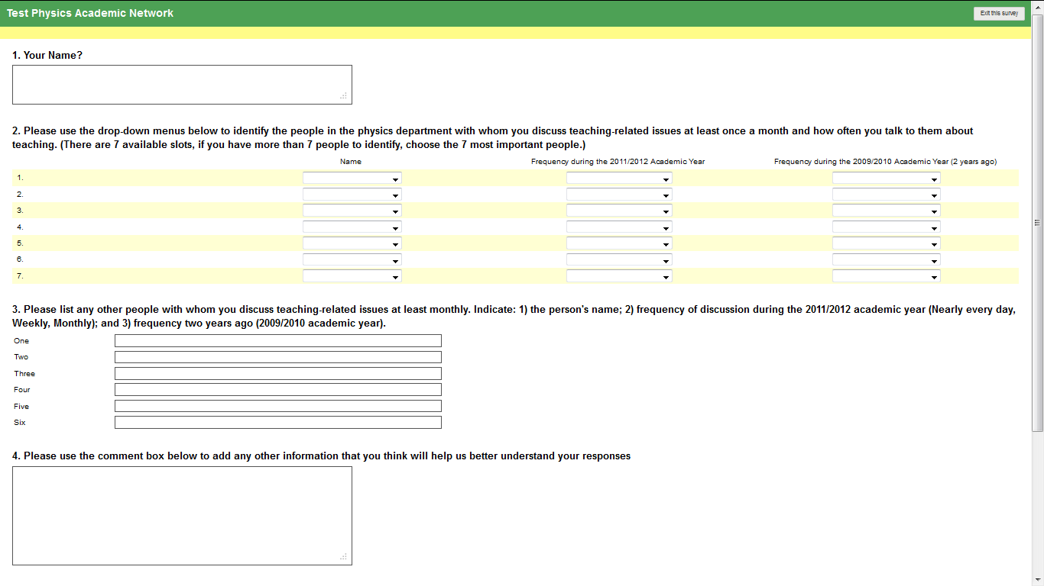
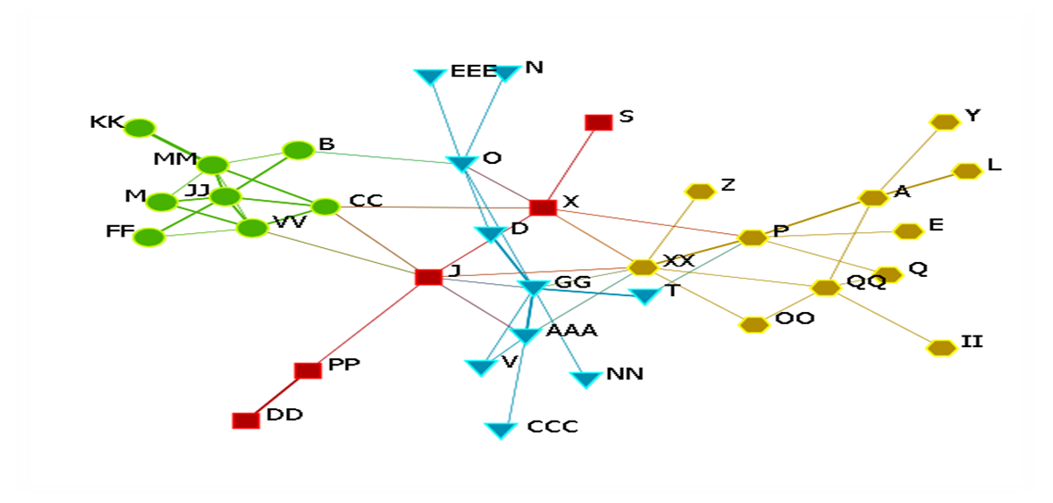
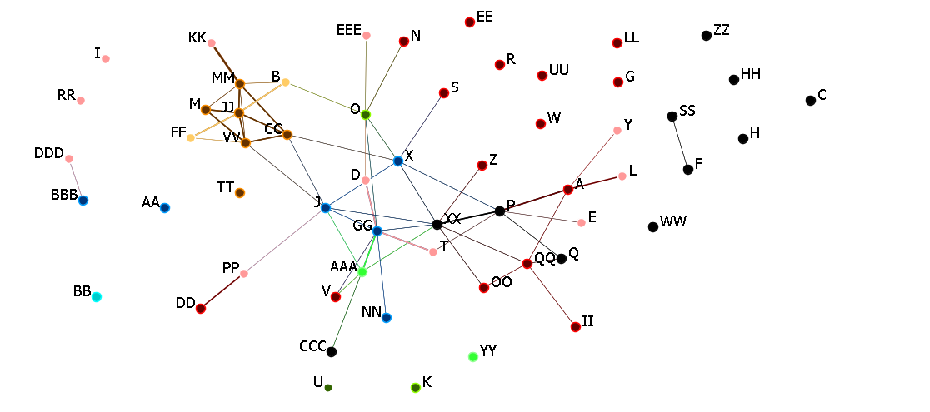
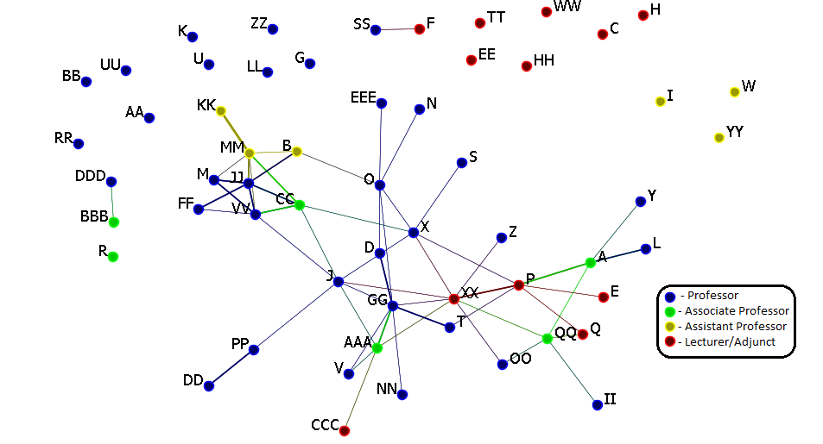
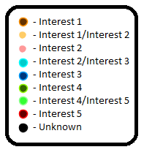
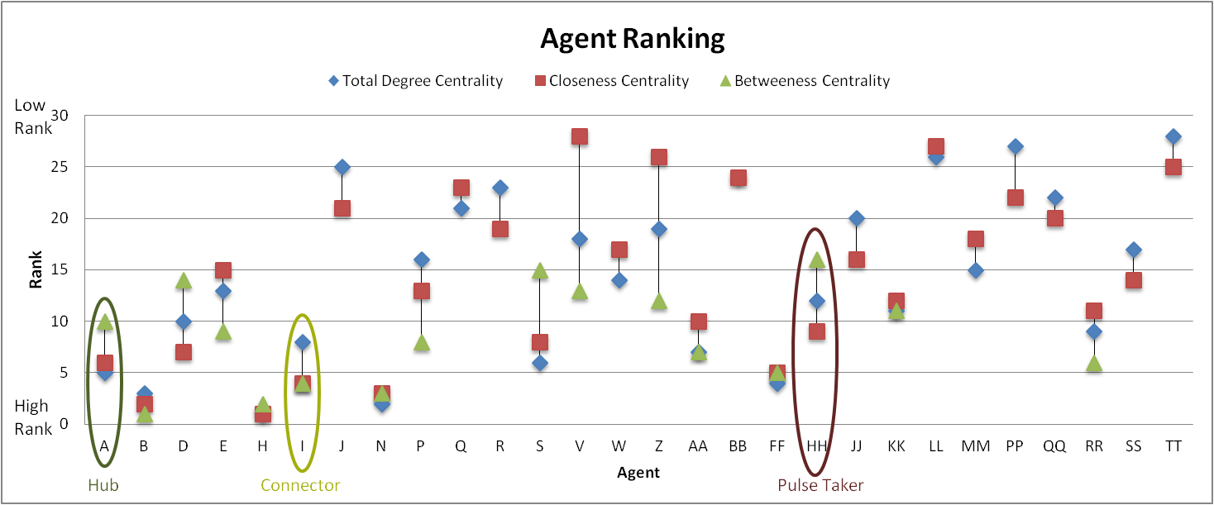
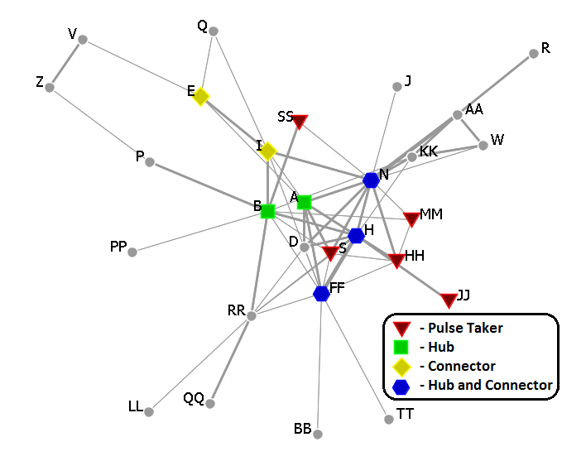
Department-Level Change Initiatives: Using Social Network Analysis to Understand the Hidden Structure of Academic Departments
Charles Henderson, Kathleen Quardokus Western Michigan University
Rationale
Results
Conclusions
The goal of this research is to develop knowledge about reform through an undergraduate department as a unit of change. This poster describes a preliminary study of the use of social network analysis as a tool to understand the hidden social structures of academic departments.
Department 1
Department 2
Community Structure
Community Structure:
The division of the networks into community structure requires identification of key actors within the entire network and within each community.
Department 2’s lack of relatively isolated sub-groups means that there are unlikely to be different ‘camps’ of faculty within the department with disjointed views about teaching and learning.
Future Work: Social Networks may be useful to document the impact of change efforts. A department-based faculty learning community may have caused the decrease in community structure of Department 2, into a more centralized group. This reduction in community structure is a positive sign for a reform that takes the department as the unit of change.
2009-2010
2009-2010
Methods
Online Survey
2011-2012
2011-2012
Q = 0.57
(moderate community structure)
Q = 0.54
(moderate community structure)
Community Structure [1]
Newman Communities:
Identify partitions (communities) within a network in such a way that the number of links between individuals within a community is as large as possible and the number of links between individuals in different communities is as small as possible.
Modularity [Q]:
The extent to which the network has modular/community structure.
Scale of 0 to 1: 0 represents no community structure (the structure that would be expected in a randomly-created network with the same number of individuals and links).
Networks with a modularity greater than .7 are rare and a modularity of less than .3 represents very low community structure.
Q = 0.56
(moderate community structure)
Q = 0.35
(low community structure)
Structure and Faculty Attributes:
Teaching-related and research-related social networks are distinct. If faculty attributes could predict teaching-related networks, there would be no need to survey faculty to develop the teaching network.
Only one community (Interest 1) was strongly associated with a research subfield, indicating that the structure is not defined by research interests.
Future Work: Is it possible to influence conversations about teaching by understanding and working through departmental research collaboration networks?
Structure and Faculty Attributes
Individual Roles [2, 3, 4]
Research Area
Individual Roles:
Hubs of information are important allies for reform leaders because these individuals can quickly spread information about procedures of the reform, as well as reform successes.
Pulse takers are important for change agents since they can provide the status of information and attitudes within the network.
Connectors can ensure the flow of information about the change effort is reaching across the network.
Future Work: Monitor the effect of using this information to identify particular faculty members to include in a change effort and for identifying the individuals that were important to information flow.
Role | Characteristics
Hubs | Significance: Have many discussions about teaching with many other individuals.
 | Calculation: High total degree centrality (number of links divided by total number of possible links).
Pulse Takers | Significance: Have many discussions with well-connected individuals, but are not themselves important links in the flow of information.
 | Calculation: High closeness centrality (the average of the shortest path to all other network members) and low betweenness centrality (how many shortest paths between pairs of network members pass through the individual).
Connectors | Significance: Promote flow of information via discussions with individuals in separated parts of the network.
 | Calculation: High betweenness centrality (how many shortest paths between pairs of network members pass through the individual).
Academic Rank
Individual Roles
References
A. Clauset, M. Newman, and C. Moore, “Finding community structure in very large networks.” Phys. Rev. E, 70(6), 1-6 (2004).
K. Stephenson, “Trafficking in Trust: The Art and Science of Human Knowledge Networks,” in Enlightened Power: How Women are Transforming the Practice of Leadership edited by L. Coughlin and E. Wingard, San Francisco: Jossey-Bass. 2005, pp. 242-265.
S. Wasserman and K. Faust, Social Network Analysis: Methods and Applications, New York: Cambridge University Press, 1994.
http://www.casos.cs.cmu.edu/projects/ora/

