Slide 1
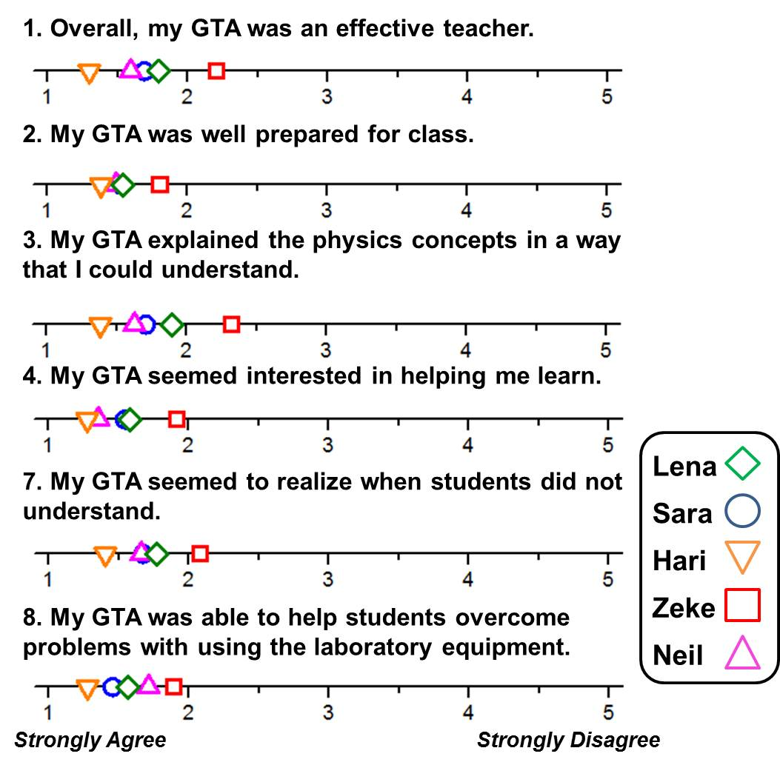
Alignment of TAs’ Beliefs with Practice and Student Perception
Jacquelyn J. Chini and Ahlam Al-Rawi– Department of Physics, University of Central Florida
Introduction
We explore how TAs’ statements about teaching during an interview aligned with their classroom practices & students’ responses to an end-of-semester evaluation.
Course: Introductory first semester algebra-based physics laboratory: traditional format, with 30 students/session, taught in Spring 2012. Recently revised (Fall 2011) to engage students in more independent thinking about experimental practice and data analysis. Revisions included: removal of detailed derivations & calculations, step-by-step instructions and ready-made data tables; addition of pre- and post-lab assignments; lab reports due at the end of the lab session.
The TAs: Six TAs were assigned to teach three or four lab sections each (five agreed to participate in research). Zeke, Neil and Sara (pseudonyms) had taught labs before revisions. Hari was teaching lab for the first time in Spring 2012. Lena began teaching in Fall 2011. TA training included weekly one-hour meetings; TAs practiced upcoming experiments and discussed difficulties from previous weeks.
Interview Analysis
Emergent themes from the interview analysis are presented below. Categories 1-3 represent specific interview questions. Category 4 was tracked across questions.
 | L | S | H | Z | N
1. Purpose of lab component
1a. Enhance students’ understanding of physics concepts | x | x | x | x | x
1b. Show how physics is related to the real world | x | x |  | x
1c. Help students learn the process of science |  |  | x
2. Students’ likes/dislikes about the lab
2a. Liked using the equipment/doing experiments | x | x | x | x | x
2b. Liked when it was easy to apply theory to experiment | x | x |  | x
2c. Disliked long calculations/derivations |  |  | x | x
2d. Disliked that information was “missing” from manual |  |  |  | x
3. TAs’ actions to support students’ experience in lab
3a. Answering student questions | x | x | x | x | x
3a-1. Answering student generated questions |  |  |  | x
3a-2. Recognizing when students needed help | x |  |  |  | x
3b. Explaining how concepts related to lab | x | x | x | x | x
3c. Giving introduction to lab | x | x | x |  | x
3c-1. Emphasized short introduction | x |  |  |  | x
3c-2. Provide “missing” information |  |  |  |  | x
4. Degree of support of lab revisions
4a. Statements in support of pre- and/or post-labs | x | x | x | x | x
4b. Statements in opposition to lab changes |  |  |  | x | x
Methodology
We compare three types of data:
Classroom: All TAs were filmed during the sixth of 14 labs (Newton’s Second Law Applications). Here, we focus on the introduction TAs gave before students began the experiment. Emergent categories from video analysis are presented.
Interview: TAs were interviewed a few weeks later about their experiences teaching the lab. Emergent categories from transcript analysis are presented.
Student ratings: Students evaluated TAs on an end-of-semester survey. Overall student ratings are presented. (Open-ended responses were also collected.)
Classroom Analysis
Lab-specific behaviors were rated for each TA as Student-centered (students required to perform the behaviors), Instructor-centered (TA performed the behaviors), or Shared (Sh) (TA lead behavior but required student involvement).
Example: For Derivation- steps, most TAs were coded as shared because they performed the derivations on the blackboard, but actively involved the students by asking questions; Hari was coded was instructor-centered because he did not involve students in the derivation.
General behaviors were rated as High, Medium or Low for how strongly they supported general course goals.
Example: Sara was coded as high because she explicitly and repeatedly reminded students that they should focus on the relationship F = ma instead of specific solutions with statements like: “You don’t need to memorize any value, right? You just remember our general equation.”
Student Ratings
Six of nine questions most closely related to Tas’ in-class interactions are presented.
Overall, students rated the TAs quite highly.
Hari scored most favorably, while Zeke scored least favorably.
Items 1 & 3 provide the most discrimination.
 | L | S | H | Z | N
Time for Intro (mins) | 6.5 | 12 | 11 | 22 | 29
Lab specific behaviors: Student-centered (St), Instructor-centered (I), or Shared (Sh)
Data table construction | St | I | St | I | I
Derivation- steps | Sh | Sh | I | Sh | Sh
Derivation- result | St | Sh | Sh | I | I
Graph interpretation | St | Sh | St | I | I
General behaviors: High (H), Medium (M), or Low (L)
Emphasized general solution methods | M | H | L | L | M
Emphasize connections | L | M | L | L | H
We thank the University of Central Florida Physics Department for support: http://physics.cos.ucf.edu.
We also thank the TAs who participated in this study.
Trends: We compare data across TAs.
Zeke emphasized student-centered instruction while also speaking against lab revisions in interview. In the classroom, he did poorly support the lab goals, but engaged in instructor-centered behavior. He received the least favorable student ratings. Thus, the least goal-supportive TA in practice is also the lowest rated.
In the interview, Hari and Sara spoke in favor of the lab goals, but describe their role as instructor-centered. In the classroom, both were relatively student-centered and Hari weakly supported lab goals. Hari was the most favorably rated, but was not the most goal-supportive.
Alignment between statements and practice appears to be weak for most TAs.
Low TA buy-in was linked to low support for course goals and lower student ratings (Goertzen et al., 2009).
Implications
TAs displayed diverse beliefs, that could serve as “productive seeds” for TA-centered training (Goertzen et al., 2010).
Many TAs’ oppositions to curricular goals were grounded in concern for students (as in Goertzen et al., 2010).
A more robust framework for identifying TAs’ resources for teaching would be beneficial (such as that under development by Spike & Finkelstein, 2011).

