Slide 1

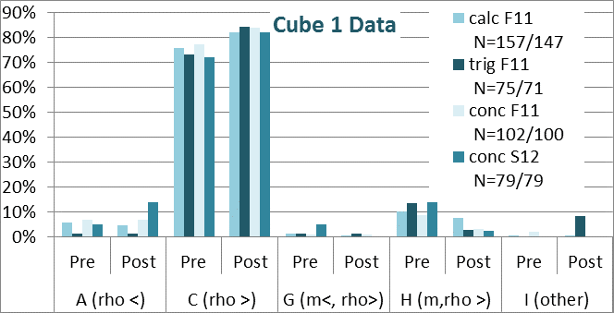
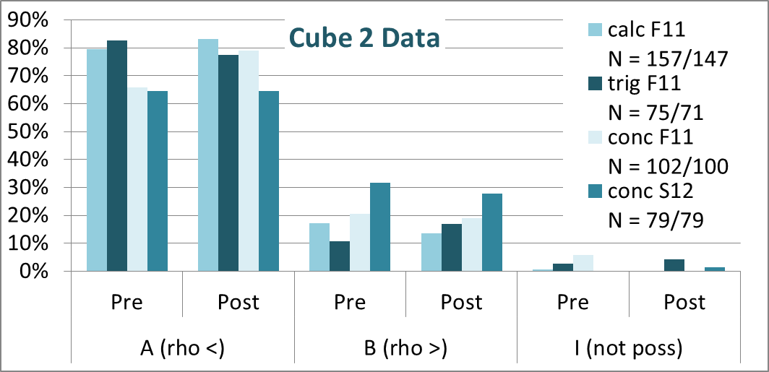
Exploring Student Difficulties with Buoyancy
DJ Wagner, Elizabeth Carbone, Sam Cohen, Matthew Goszewski, Kathryn Merrymon, and Adam Moyer
Grove City College
Abstract
Our Questions
Conclusion
Our research group is developing a standardized fluids assessment, covering buoyancy and pressure. Understanding buoyancy requires a battery of skills and knowledge, and we have designed questions to probe understanding of background concepts such as density, incompressibility, and volume of fluid displaced. In this talk we will describe some of the buoyancy-related assessment questions, the misconceptions they probe, and the preliminary results from the beta version of the assessment.
“Steel Float”
You find that a particular rectangular chunk of steel sinks when you release it while it is completely submerged in a tank of alcohol. Which of the following actions could result in your steel floating at equilibrium at the top of the container (after releasing when submerged)? Choose all which apply.
Breaking the chunk into tiny pieces of steel and placing the pieces in the tank.
Putting the steel chunk through a rolling machine to make it flatter and increase the horizontal surface area.
Drilling a hole all the way through the steel.
Adding more alcohol to the tank.
Removing alcohol from the tank.
Reshaping the steel to make the bottom more rounded.
None of the above will result in the steel floating.
“Styrofoam Sink”
You find that a particular rectangular-shaped piece of Styrofoam floats when you release it while it is completely submerged in a tank of saltwater, with the wider edges on the top and bottom. Which of the following actions could result in the Styrofoam sinking to the bottom of the container (after releasing when submerged)? Choose all which apply.
Carving the bottom side of the Styrofoam into a pointed surface.
Rotating the Styrofoam so the narrower edges are on the top and bottom.
Drilling a hole all the way through the Styrofoam.
Pushing the Styrofoam down so it is completely submerged, and then releasing it.
Adding saltwater to the tank.
Removing saltwater from the tank.
Piling more Styrofoam on top of the piece.
Placing the Styrofoam in a tank of a lower-density liquid.
None of the above could result in the Styrofoam sinking.
“Cube 1”
A solid cube sinks when placed in a container of alcohol, as shown to the right. Which of the following statements is/are necessarily correct?
The cube has a lower density than alcohol.
The cube has less mass than alcohol.
The cube has a higher density than alcohol.
The cube has more mass than alcohol.
Both A and B must be true, if the cube is to sink.
Both A and D must be true, if the cube is to sink.
Both B and C must be true, if the cube is to sink.
Both C and D must be true, if the cube is to sink.
Whether an object sinks depends upon factors other than mass and density.
“Cube 2”
A solid cube floats when placed in a container of water, as shown to the right. When placed in a container of an unknown fluid, the cube is seen to sink to the bottom of the container in that new fluid. Which of the following statements is/are necessarily correct?
The unknown fluid has a lower density than water.
The unknown fluid has a higher density than water.
The amount of unknown fluid in the second container is larger than the amount of water in the original container.
The amount of unknown fluid in the second container is less than the amount of water in the original container.
Both A and C must be true, for a cube that floats in water but sinks in the new fluid.
Both A and D must be true ….
Both B and C must be true ….
Both B and D must be true ….
This is not a physically possible situation; the
fluid itself does not determine sinking or floating.
While the “heavy sinks” conception permeates the literature, it was not prominent in our data. Nor did our students exhibit a widespread belief that the amount of fluid matters. Instead, our students generally recognize that density determines buoyancy. Application of that knowledge, however, is trickier. Other portions of our diagnostic test have identified profound student difficulties with the concept of density [16]. In particular, students do not acknowledge/apply the idea of density as a fixed property of a solid substance. This confusion could lead to the “hole sinks” or “little pieces float” conceptions.
Due to space constraints, this paper focuses solely on the effect of material-dependent properties on buoyancy. Other questions in our diagnostic address depth-dependence and the understanding of volume displaced, as well as buoyant force and Newton’s Laws. Analysis of that data is ongoing and will be reported later.
As we edit the diagnostic questions, we will seek to try our questions with different samples. In particular, we would like to examine the ideas of high school students, who are closer in age to the subjects of most studies of buoyancy.
Introduction
As part of the development of a fluids statics diagnostic, we are examining student conceptions of buoyancy. Many of the distractors for our questions are based on conceptions identified by others [1-14]. Since only [2-5] involve college students, and very few [6-7] of the others involve students above the age of 15, we wondered which of the difficulties identified in those papers would still be significant in college courses. ([8] does include in-service teachers, but the focus is children.)
Our investigations, combined with a review of the literature, have identified the following common student conceptions about buoyancy:
Heavy sinks, light floats [mentioned in nearly all studies].
Large sinks; small floats, or small sinks, large floats [6-7,9-13].
Volume of fluid displaced is proportional to mass, not volume of submerged object [4,6,9].
Flat/large surface area floats [3,7,10,13].
Sharp or pointed sinks [6-8,12-13].
Drilling hole cause sinking [6,8,12,13] or floating [10].
Floatation caused by amount of air in object [3,6,13,14].
Amount of fluid in container affects buoyancy [3,6,9,12,13].
More dense floats; less dense sinks [7,10,12].
Less dense fluid exerts larger buoyant force [9-10].
Buoyancy independent of fluid properties [3,9].
Buoyant force and/or volume displaced increases with depth [3-5,9-10,14] or decreases with depth [9,14].
Volume displaced = total volume of floating object [4].
References
1. B. Inhelder and J. Piaget, The growth of logical thinking from childhood to adolescence. New York: Basic Books, 1958.
2. U. Besson, Int J Sci Educ 26, 1683-1714 (2004).
3. E. R. Duckworth, “Inventing density.” in Grand Forks, ND, North Dakota Study Group on Evaluation, Center for Teaching and Learning, University of North Dakota, 1986. (WWW document)
4. M.E. Loverude, C.H. Kautz, and P.R.L. Heron, Am. J. Phys. 71, 1178–1187 (2003).
5. M.E. Loverude, Am. J. Phys. 77, 897-901 (2009).
6. J. McKinnon, J. Geol. Educ. 19, 218 (1971).
7. F. F. Camacho and L. G. Cazares, Sci. Educ. 82, 15–29 (1998).
8. M.G. Hewson, Sci. Educ. 70, 159–170 (1986).
9. D. Wong, C. C. Lim, S. Munirah and S. K. Foong, poster at 2010 Physics Education Research Conference. (WWW document http://www.compadre.org/per/perc/2010/Detail.cfm?id=3543 Downloaded 7/5/2012.)
10. S. Gang, Phys. Teach. 33, 346-354 (1995)..
11. J. A. Rowell and C. J. Dawson, Sci. Educ. 61, 245–253 (1977).
12. S. Ünal and B. Coştu, Problematic issue for students: Does it sink or float? Asia-Pacific Forum on Science Learning and Teaching 6(1) (2005).
13. Y. Yin, M.K. Tomita, and R.J. Shavelson, Science Scope 34, 34-39 (2008).
14. F. Biddulph and R. Osborne, Res Sci Ed 14, 114–124 (1984).
15. The Physics Education Group at the University of Washington, L. C. McDermott, and P. S. Shaffer, Tutorials in Introductory Physics, Upper Saddle River: Prentice-Hall, 2002.
16. See “What College Students Don’t Know about Density,” a talk by Wagner at Omaha AAPT meeting and paper soon to be submitted for publication.
Results
“Calc” = calc-based course for engineers/physicists, “Trig” = trig-based course for biology majors and pre-meds, “Conc” = conceptual-based gen-ed course. “F11” = Fall, 2011 semester, etc. “Pre”-instruction assessment given first week of workshop; “Post” given last week of workshop. “rho >” = density of block [Cube 1] or new fluid [Cube 2] greater than density of [original] fluid. Responses not chosen by more than 4% from students have not been included in graphs for Cube data.
TABLE 1. Possible answers to Steel float, with conception and % students choosing by course. (Totals add to more than 100% since the question is multiple-select.)
Steel float answers | Conception | CalcF11 |  | TrigF11 |  | ConcF11 |  | ConcS12
 |  | Pre | Post | Pre | Post | Pre | Post | Pre | Post
Breaking the chunk into tiny pieces … | Small floats | 20 | 13 | 25 | 14 | 26 | 10 | 24 | 9
B. Putting the steel chunk through a rolling machine … | Flat floats | 40 | 33 | 45 | 48 | 29 | 39 | 38 | 35
C. Drilling a hole all the way through the steel. | Hole floats | 6 | 4 | 7 | 0 | 16 | 4 | 10 | 4
D. Adding more alcohol to the tank. | F_{B} ~ V_{fluid} | 3 | 2 | 9 | 4 | 11 | 1 | 14 | 0
E. Removing alcohol from the tank. | F_{B} ~ 1/V_{fluid} | 0 | 2 | 0 | 0 | 5 | 2 | 5 | 6
F. Reshaping the steel to make the bottom more rounded. | Sharp sinks | 24 | 17 | 31 | 56 | 23 | 59 | 23 | 56
G. None of the above will result in the steel floating. | Correct | 35 | 46 | 33 | 23 | 31 | 16 | 30 | 11
TABLE 2. Possible answers to Styrofoam sink, with conception and % students choosing by course. (Totals add to more than 100% since the question is multiple-select.)
Steel float answers | Conception | CalcF11 |  | TrigF11 |  | ConcF11 |  | ConcS12
 |  | Pre | Post | Pre | Post | Pre | Post | Pre | Post
A. Carving the bottom … into a pointed surface. | Sharp sinks | 10 | 4 | 9 | 10 | 5 | 13 | 6 | 6
B. Rotating … so the narrower edges … | Flat floats | 4 | 5 | 17 | 13 | 9 | 11 | 4 | 9
C. Drilling a hole all the way through the Styrofoam. | Hole sinks | 18 | 8 | 8 | 8 | 17 | 14 | 14 | 20
D. Pushing the Styrofoam down … | Air floats | 8 | 5 | 11 | 3 | 13 | 5 | 9 | 8
E. Adding saltwater to the tank. | F_{B} ~ 1/V_{fluid} | 1 | 1 | 0 | 1 | 4 | 6 | 8 | 5
F. Removing saltwater from the tank. | F_{B} ~ V_{fluid} | 8 | 3 | 8 | 1 | 10 | 4 | 10 | 11
G. Piling more Styrofoam on top of the piece. | Heavy sinks | 12 | 7 | 9 | 14 | 16 | 6 | 10 | 6
H. Placing … in a tank of a lower-density liquid. | correct | 75 | 72 | 72 | 80 | 61 | 62 | 58 | 63
I. None of the above … | other | 8 | 16 | 17 | 14 | 21 | 16 | 16 | 14
Acknowledgements
Partial support for this work has come from the Swezey Scientific Instrumentation and Research Fund. The authors would also like to thank the other members of the GCC PER group who have contributed to this project: Zachary Bazan and Jason Wetstone.

