Slide 1

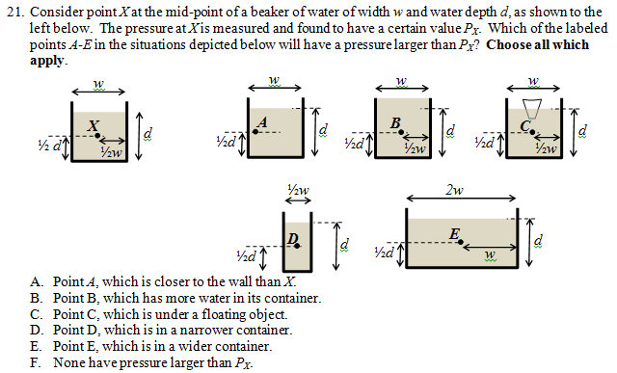
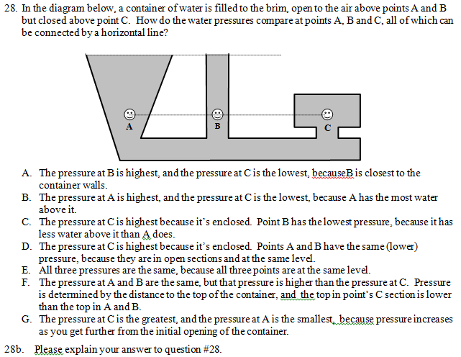
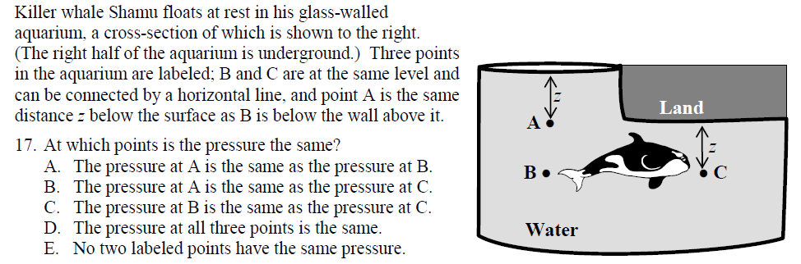
Exploring Student Difficulties with Pressure in a Fluid
Matthew Goszewski, Adam Moyer, Zachary Bazan, and DJ Wagner
Grove City College
Abstract
Container Effects on Pressure
Conclusion
Our research group is developing a standardized fluids assessment, covering buoyancy and pressure. Much of the prior research of student difficulties with pressure involves young children. Many of the questions on the beta-version of the assessment used this past year were designed to test the prevalence of those difficulties in college students. In this talk we will describe the pressure-related assessment questions, the misconceptions they probe, and the preliminary results from the beta version of the assessment.
Our college students show many of the same difficulties with pressures identified by studies involving younger students. Targeted instruction using the Tutorials [9] in Trig and Calc courses seem to address difficulties with the definition of depth, the belief that the amount of water above a point affects pressure, and that “enclosure” matters. In contrast, “amount above” and “enclosed” conceptions persist in our Conc class (which has no workshop time spent on pressure). We did not see a strong number of students suggesting that pressure is larger at points closer to a wall, or that the pressure is the same everywhere in a fluid. Besides seeing more improvement in the Calc and Trig classes overall, the Large P question was significantly harder for the classes to get correct. We will continue to refine our diagnostic questions to better distinguish between specific conceptions, and to address each conception multiple times.
 |  | Correct Answer |  |  |  | Enclosed/below obj. → high P |  |  |  | Close wall/narrow → high P
Course & Sem | N | Large P (B) |  | 3-Shape (E) |  | Large P (C) |  | 3-Shape (C,D) |  | Large P (A,D) |  | 3-Shape (A)
 | Pre Post | Pre | Post | Pre | Post | Pre | Post | Pre | Post | Pre | Post | Pre | Post
Calc F11 | 147 | 34 | 54 | 27 | 85 | 13 | 6 | 36 | 6 | 22 | 9 | 5 | 1
Trig F11 | 71 | 25 | 49 | 12 | 76 | 20 | 8 | 42 | 14 | 40 | 7 | 4 | 0
Conc F11 | 100 | 17 | 38 | 11 | 37 | 25 | 14 | 36 | 26 | 30 | 23 | 4 | 3
Conc S12 | 79 79 | 25 | 23 | 3 | 33 | 25 | 14 | 52 | 26 | 34 | 30 | 9 | 4
Large P
One of the conceptions that we were testing for is that students believe Horizontal Pressure on a point comes from a different cause than Vertical Pressure on a point [3-7]. This table looks at the horizontal pressure conceptions on the Large P and 3-Shape questions. The Pre test shows that less than 35% of the students could correctly answer each question. Interestingly 36-52% of the students said (pre-instruction) that a more enclosed container has more pressure in the 3-Shape question but less than 25% of students gave the same reasoning in the Large P question. On the Large P question, 30-40% of students said pressure is higher closer to the walls, while less than 10% claimed the same reasoning on the 3-Shape.
The Post Test showed more improvement on the 3-Shape question than the Large P question. The Large P had poor post-instruction performance in all classes, most likely because the question has a more complex appearance than the 3-Shape. The Conc classes generally saw improvement on both questions but still less than 40% of selected the correct answer at the end of the semester.
References
1. M. Mayer, “Common sense knowledge versus scientific knowledge: The case of pressure, weight, and gravity” in Proceedings of the Second International Seminar: Misconceptions and Educational Strategies in Science and Mathematics, edited by J. D. Novak, Cornell University, Ithaca, NY, 1987, pp. 298–310
2. P. A. Giese, “Misconceptions about water pressure” in Proceedings of the Second International Seminar: Misconceptions and Educational Strategies in Science and Mathematics, edited by J. D. Novak, Cornell University, Ithaca, NY, 1987, pp. 141–148.
3. This conception is mentioned in reference [8] and in P. Kariotoglou, D. Psillos, and O. Vallassiades, Phys. Educ. 25, 92-96 (1990); the original study eliciting this conception appears to be the following, of which we have not been able to obtain a copy: D. Koliopoulos, P. Kareiotoglou, and D. Psillos. “La force dans le contexte des liquides: une premiere approche des college en Grece,” Feuilles d' Epistemologie Appliquee et de didactique des sciences, pp. 59-65 (1986).
4. M. E. Loverude, P. R. L. Heron, and C. H. Kautz, Am. J. Phys 78, 75 (2010).
5. E. Engel Clough, and R. Driver, Research in Science & Technological Education 3, 133-144 (1985).
6. P. P. Kariotoglou, and D. D. Psillos, Research In Science & Technological Education 11, 95-108 (1993).
7. G. Fassoulopoulos, P. Kariotoglou, and P. Koumaras, Res Sci Ed, 33, 71-87 (2003).
8. F. F. Camacho and L. G. Cazares, Sci. Educ. 82, 15–29 (1998).
9. The Physics Education Group at the University of Washington, L. C. McDermott, and P. S. Shaffer, Tutorials in Introductory Physics, Upper Saddle River: Prentice-Hall, 2002.
10. The “3-shape” question is a modification from one developed by James Vesenka and presented at the Jacksonville AAPT Winter 2011 meeting.
Determining Depth
3-Shape [10]
 |  | Correct Answer |  |  |  | h measured to boundary |  |  |  | Amount above matters
Course & Sem | N | Shamu (C) |  | 3-Shape (E) |  | Shamu (B) |  | 3-Shape (F) |  | Shamu (E) |  | 3-Shape (B,C)
 | Pre Post | Pre | Post | Pre | Post | Pre | Post | Pre | Post | Pre | Post | Pre | Post
Calc F11 | 147 | 50 | 93 | 27 | 85 | 24 | 3 | 8 | 3 | 17 | 1 | 40 | 5
Trig F11 | 71 | 40 | 94 | 12 | 76 | 32 | 3 | 9 | 7 | 24 | 1 | 29 | 9
Conc F11 | 100 | 38 | 47 | 11 | 37 | 26 | 28 | 10 | 18 | 26 | 3 | 35 | 22
Conc S12 | 79 79 | 34 | 42 | 3 | 33 | 25 | 34 | 3 | 8 | 22 | 16 | 51 | 42
The other conception that this poster addresses is how students measure the vertical pressure on a point [1-4, 7, 8]. Some students decide that the depth of a point is due to the height to the container directly above the point instead of the height to the top of the system where the pressure equals 1 atm. Other students think that if there is a great volume of water above the point it will have a higher pressure. Less than 50% of students correctly answered the Shamu question and less than 30% correctly answered the 3-Shape question on the Pre test. The height directly above a point conception was mostly seen in the Shamu question, while the volume of water above a point misconception was evident in both of the questions (pre-instruction). Post tests showed that the Calc and Trig classes made large improvement but the Conc classes remained below 50% correct. Also the higher post-test scores were seen in the Shamu question, with the fraction of students choosing the “volume of water increases pressure” options decreasing significantly. It can be noted that the Conc classes were more likely to choose the “height directly above a point” conception in the Post test than in the Pre test.
Shamu
Calc -> calculus-based course for engineers, computer scientists, and physics majors
Trig -> trig-based course for biology and chemistry majors
Conc -> concept-based course for non-science majors
F11 -> Fall 2011 Semester Course
S12 -> Spring 2012 Semester Course
Pre -> Test given first week in lab, no classroom teaching
Post -> Test given at the last lab, after classroom teaching
Acknowledgements
Partial support for this work has come from the Swezey Scientific Instrumentation and Research Fund. The authors would also like to thank the other members of the GCC PER group who have contributed to this project: Elizabeth Carbone, Sam Cohen, Kathryn Merrymon, and Jason Wetstone.

