Slide 1
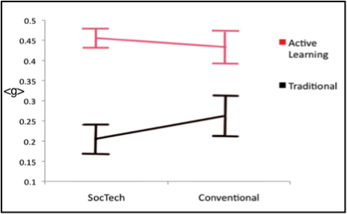
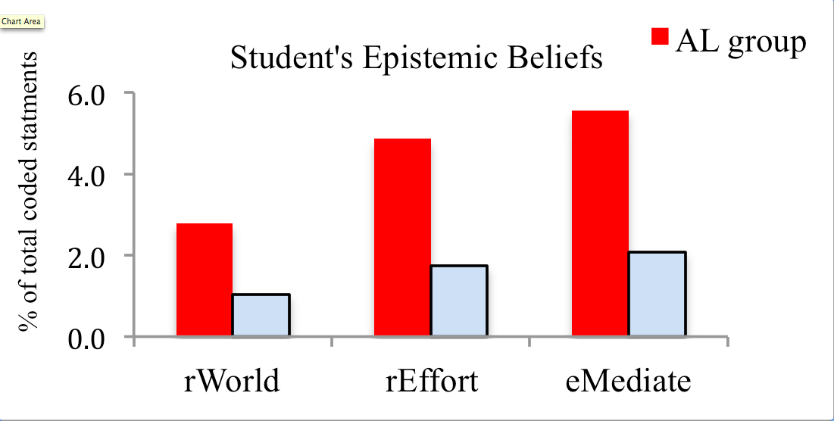
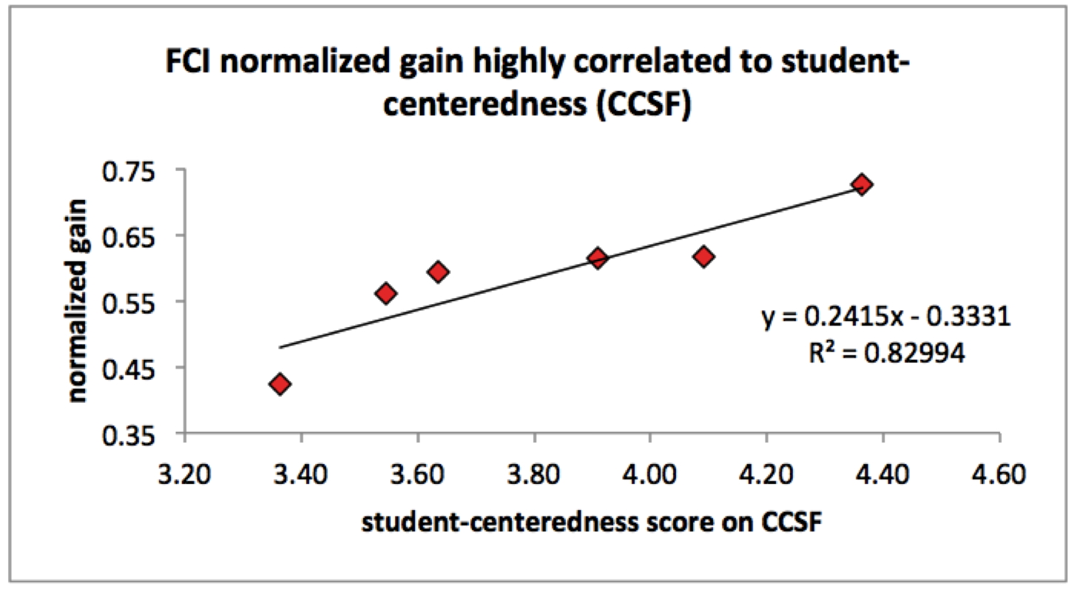
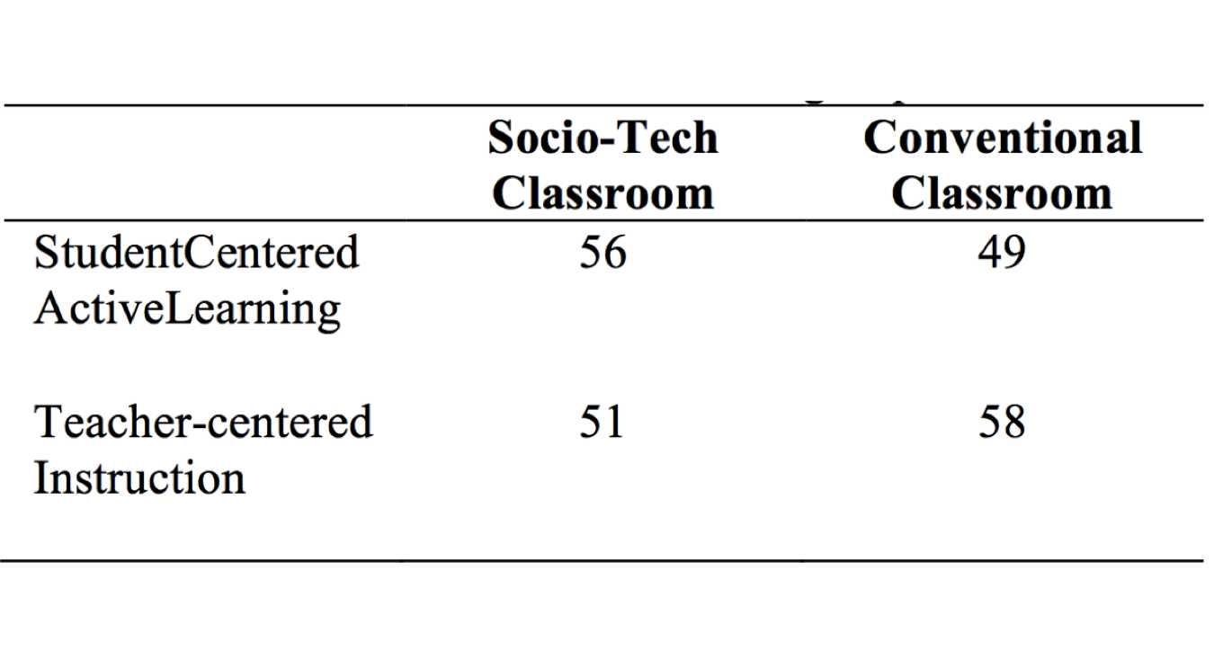
When Classrooms are Technology Rich & Pedagogy Poor
2
Nathaniel Lasry^{1,2,3}, Elizabeth Charles^{2,3,4}, Chris Whittaker^{3,4}
Abstract
Results
Technology-rich classrooms like SCALE-UP or TEAL are designed to be centered around students and actively engage them. We examine what happens when instructors adopt the classroom but not the pedagogy that goes with it. We assessed the pedagogy of 6 participating instructors (active learning vs. conventional instruction) using the Attitudes towards Instruction (ATI: Trigwell & Prosser, 2004) and through qualitative observations. We assessed students on the FCI at the beginning and end of the term and conducted interviews with 34 students to gauge their perceptions of the redesigned spaces as a function of the pedagogy they were exposed to. Last, we correlate instructors’ self-reported instructional approach (teacher-centered vs student-centered) with the average normalized gains of their classes. Our findings suggest that technology-rich spaces are only effective when implemented with active pedagogies. Without active pedagogy, the technology-rich environment is not significantly different from conventional teacher-centered classrooms. We also find that students in socio-technological spaces have more expert-like epistemic beliefs when exposed to active learning pedagogy. We also find that instructors’ self-reported perception of student-centeredness accounts for a large fraction of the variance (R²=0.83) in their class’ average normalized gain.
1- Active Learning matters, classroom design, well…
Active Learning pedagogies produce larger normalized gains, regardless of classroom design. Classroom designs do not significantly differ from each other. Largest gains are found in socio-technological designs that use Active Learning. Smallest normalized gains are found in socio-technological designs that use traditional teacher-centered pedagogies.
2- Tech-rich AL Students have more expert like epistemologies
Three epistemic sub-components of perceptions/beliefs emerge: (a) relates to real world phenomena (real world), (b) takes additional work outside of class (requires effort), and (c) requires access to a variety of experiences in the classroom (experientially mediated).
Students’ epistemic perceptions/beliefs in tech-rich classrooms depend on the kind of pedagogy they were exposed to: active learning students display more expert-like epistemic beliefs
Method
Measures
1) Assessing 6 Instructors’ Pedagogy : student centered vs teacher centered
- Researchers we invited to attend classes
- Instructors completed the 22-item Approaches to Teaching Inventory (ATI)
- ATI is a self-report instrument that instructors complete. Has 2 sub-scales
- Conceptual change/student focused (CCSF) ; 11 items
- Information transmission/teacher focused (ITTF) ; 11-items
(Trigwell & Prosser, 2004)
2) Students’ learning gains (FCI pre-post)
3) Conducted 34 interviews on students’ perceptions of SCALE-UP
SAMPLE
Students in algebra-based mechanics course at Dawson College (n=214) and 6 different instructors distributed as follows:
3- Teachers’ self-report of student-centeredness correlates with <g>
We find a surprisingly high correlation (r = 0.91) between normalized gain and self-reported student-centeredness (CCSF) but not with teach-centerdness (ITTF). We find striking the notion that such a large fraction of the variance (R2=0.83) in average FCI gain for a class can be explained by the instructor’s perception of student- centeredness. The corrolary being that changing a teachers perception of teaching can have a profound impact on students.
Conclusion
1) Active Learning is paramount
2) Male sure teachers using SCALE-UP rooms can use Active Learning;
Else, maybe better off not using the room…
3) Students have greater conceptual gains AND more expert-like epistemologies when SCALE-UP used with Active Learning
4) The way teachers view how student-centered they are; is really important!
This study was supported by:

