Slide 1
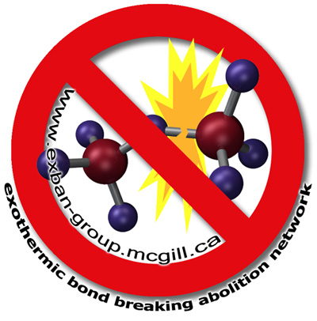
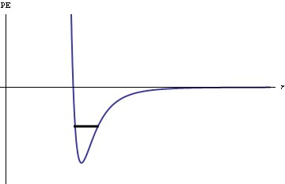
Students’ Interdisciplinary Reasoning about “High-Energy Bonds” and ATP Benjamin W. Dreyfus, Benjamin D. Geller, Vashti Sawtelle, Julia Svoboda, Chandra Turpen, & Edward F. Redish Department of Physics, University of Maryland, College Park
ATP: “the energy currency of the cell”
Student difficulties with ATP
ATP in a physics class?!
ATP (adenosine triphosphate) is produced during cellular respiration and photosynthesis.
In the ATP hydrolysis reaction (below), a bond is broken to remove the terminal phosphate group from ATP, and other bonds are formed.
As a shorthand, biology texts and instructors often refer to the phosphate bond in ATP as a “high-energy bond.”
It is well-documented in the biology [1] and chemistry education literatures [2-4] that students will express the idea that energy is released when bonds are broken, or conversely, that energy is required to form a bond (both in ATP and in general).
During the 2011-12 school year, we piloted a new introductory physics course [5] for undergraduate biology majors. The course requires biology and chemistry as prerequisites, and emphasizes building cross-disciplinary coherence.
One focus of the curriculum was developing coherent models of energy and thermodynamics that bridge physics, chemistry, and biology.
The literature has typically treated this as a “misconception.”
Teichert & Stacy [3] show that students can simultaneously express the idea that energy is released when a bond is formed, and that energy is released when a bond is broken.
Therefore, the course included an extensive thread on chemical bond energy, linking chemical bonds to electric potential energy and to energy conservation (the First Law of Thermodynamics).
The bonds that are formed are stronger than the original phosphate bond, so energy is released.
This energy is used to power various cellular processes, so ATP has a prominent role in the molecular biology curriculum.
Quiz question on “high-energy bonds”
Student interview data on the ATP quiz question
We gave our students this quiz question, taken from the chemistry education literature [4], instructing them to select all correct answers.
Our two case-study students, “Gregor” and “Wylie,” both answered BCD on the quiz, choosing both the “correct” answers and the answer labeled as a “misconception.” What were they thinking?
An O-P bond in ATP is referred to as a “high-energy phosphate bond” because
The bond is a particularly stable bond.
The bond is a relatively weak bond.
Breaking the bond releases a significant quantity of energy.
A relatively small quantity of energy is required to break the bond.
Gregor
Wylie
At least in retrospect, Gregor and Wylie understand that it’s “obviously” not true that breaking a bond releases energy.
I put that when the bond's broken that's energy releasing. Even though I know, if I really think about it, that obviously that's not an energy-releasing mechanism. Because like, you can't break a bond and release energy, like you always need to put energy in, even if it's like a really small amount of energy to break a bond.
[Talking about a general case when bonds are formed:] When they came together, when that happened, that's when energy was released. And in this case [ATP], if you follow this logic, you would say … when you're breaking this stuff down, that's when energy is released. So, you know, there's obviously a conflict…
Results:
(N=19)
However, they don’t back down from their “wrong” answers – they explain that breaking the bond in ATP leads to the release of energy.
When I was taking the test, I guess I was thinking breaking this bond then leads to these other reactions inevitably. That result in an energy release … I don't [argue] that breaking a bond releases energy, but just like in a larger biological context, that reaction does release energy.
ATP breaks down into ADP plus something. There's a bond formed between the phosphate and something that makes it more stable. And this part is the part that releases the energy. … It's not the breaking of the bond that's releasing the energy. Because when, in breaking of the bond, you actually require energy, but the result of the breaking of the bond is that you get energy.
A | 32%
B | 47%
C | 79%
D | 26%
The large percentage of students selecting C was comparable to the results in Galley’s original paper [4], which identified “exothermic bond-breaking” as a “persistent misconception.” But is that all it is? The qualitative data from student interviews tell a more complex story.
Implications: A vision for interdisciplinary education
They tie this difference in perspectives to the disciplines.
They see physics as focusing on a narrower phenomenon (the breaking of the bond on its own) and biology as focusing on the broader context (the entire ATP hydrolysis reaction). Either answer could be correct, depending on whether we’re doing physics or biology.
I guess that's the difference between like how a biologist is trained to think, in like a larger context and how physicists just focus on sort of one little thing.
[...]
I guess that's just the difference between physics and chemistry and biology. … It's just your scale. Like, physics really love to think about things in vacuums, and like without context, in a lot of senses. So, you just think about like whatever small system you're-- isolated system you're looking at, and I guess chemist or biologists thinking about more of like an overall context, that like wherever a reaction or process is happening, like that's important to what's going on.
Wylie: If … that same question was in a biology course, and I picked C, I would get points.
Interviewer: Why do you think that is?
Wylie: Because I think in the biology course, the focus of the question would be on the significant quantity of energy, not necessarily breaking the bond. … Breaking the bond in ATP gives you energy. That's what a biologist might think. … But this is more specific. This is going into, you know, exact details.
Depending on the question they are trying to answer, students may make different choices about how to bound the system of interest.
ATP hydrolysis:
Breaking the phosphate bond in ATP
Formation of new bonds
They see these choices as connected to the disciplines.
“Physics”?
“Biology”?
Breaking a bond requires an input of energy
Breaking the phosphate bond in ATP releases energy
These modeling choices can lead to conclusions that seem contradictory on the surface, but each may be correct in the appropriate context.
References
[1] S. Novick, “No energy storage in chemical bonds”, J. Biol. Ed. 10, 116 (1976); C. Gayford, “ATP: A coherent view for school advanced level studies in biology”, J. Biol. Ed. 20, 27 (1986)
[2] H.K. Boo, “Students’ understandings of chemical bonds and the energetics of chemical reactions”, J. Res. Sci. Teach. 35, 569 (1998)
[3] M.A. Teichert & A.M. Stacy, “Promoting understanding of chemical bonding and spontaneity through student explanation and integration of ideas”, J. Res. Sci. Teach. 39, 464 (2002)
[4] W.C. Galley, “Exothermic bond breaking: a persistent misconception”, J. Chem. Ed., 81, 523 (2004)
[5] http://umdberg.pbworks.com/w/page/44091483/Project%20NEXUS%20UMCP
Acknowledgments
This work is supported by the NSF Graduate Research Fellowship (DGE 0750616), NSF-TUES DUE 11-22818, and the HHMI NEXUS grant. Many thanks to the University of Maryland Physics Education Research Group (PERG) and Biology Education Research Group (BERG).
Contact: dreyfus@umd.edu
As long as students can reconcile these seemingly contradictory ideas, maintaining this context-dependent reasoning may actually be productive.
The goals of interdisciplinary education include being able to reason within each discipline, using its own native tools, in ways that are informed by and coherent with the other disciplines. It is not sufficient to merge the disciplinary perspectives into a single model; rather, the work of reconciling includes developing the flexibility to move among multiple models.

