Slide 1
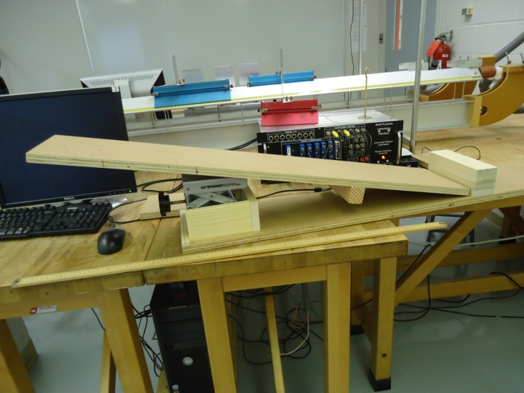
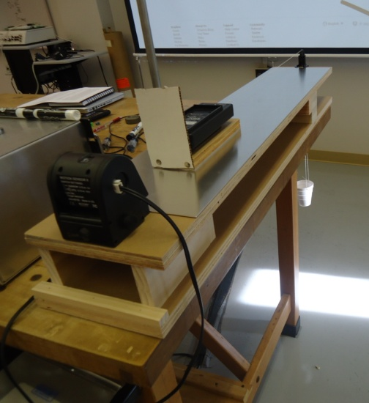
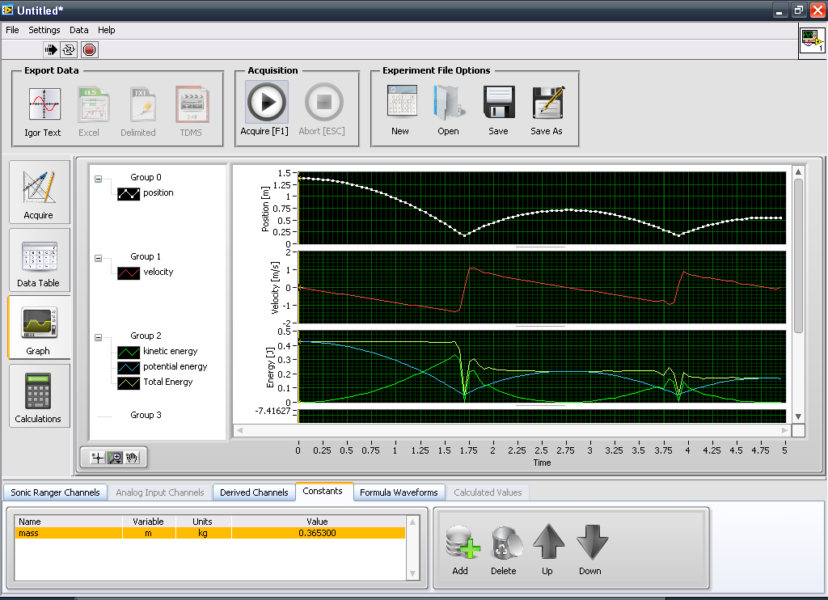
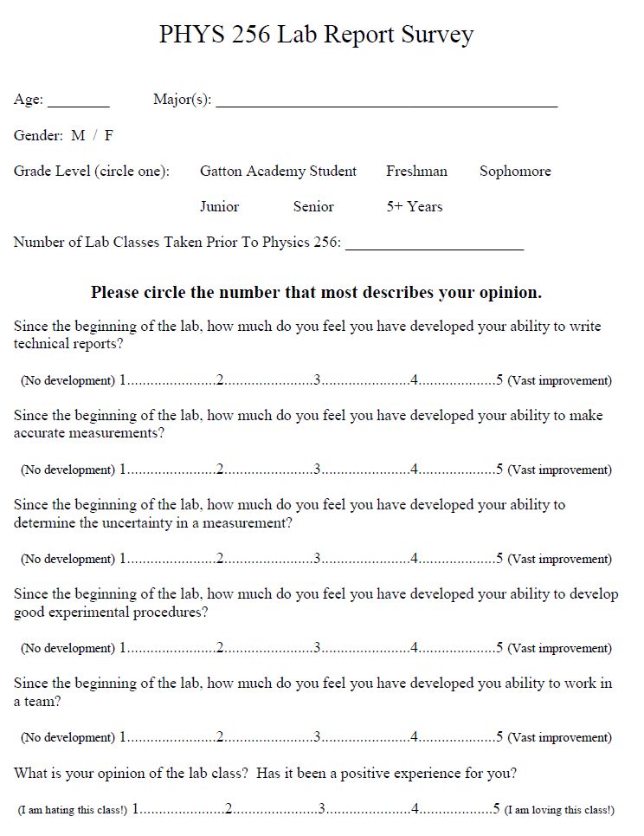
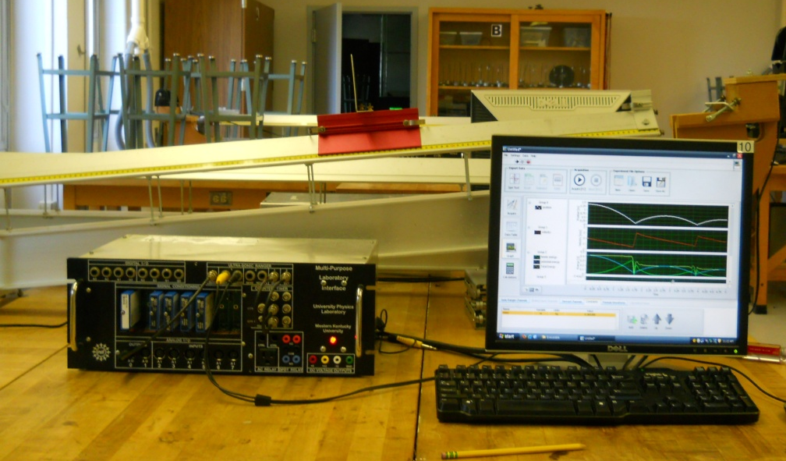
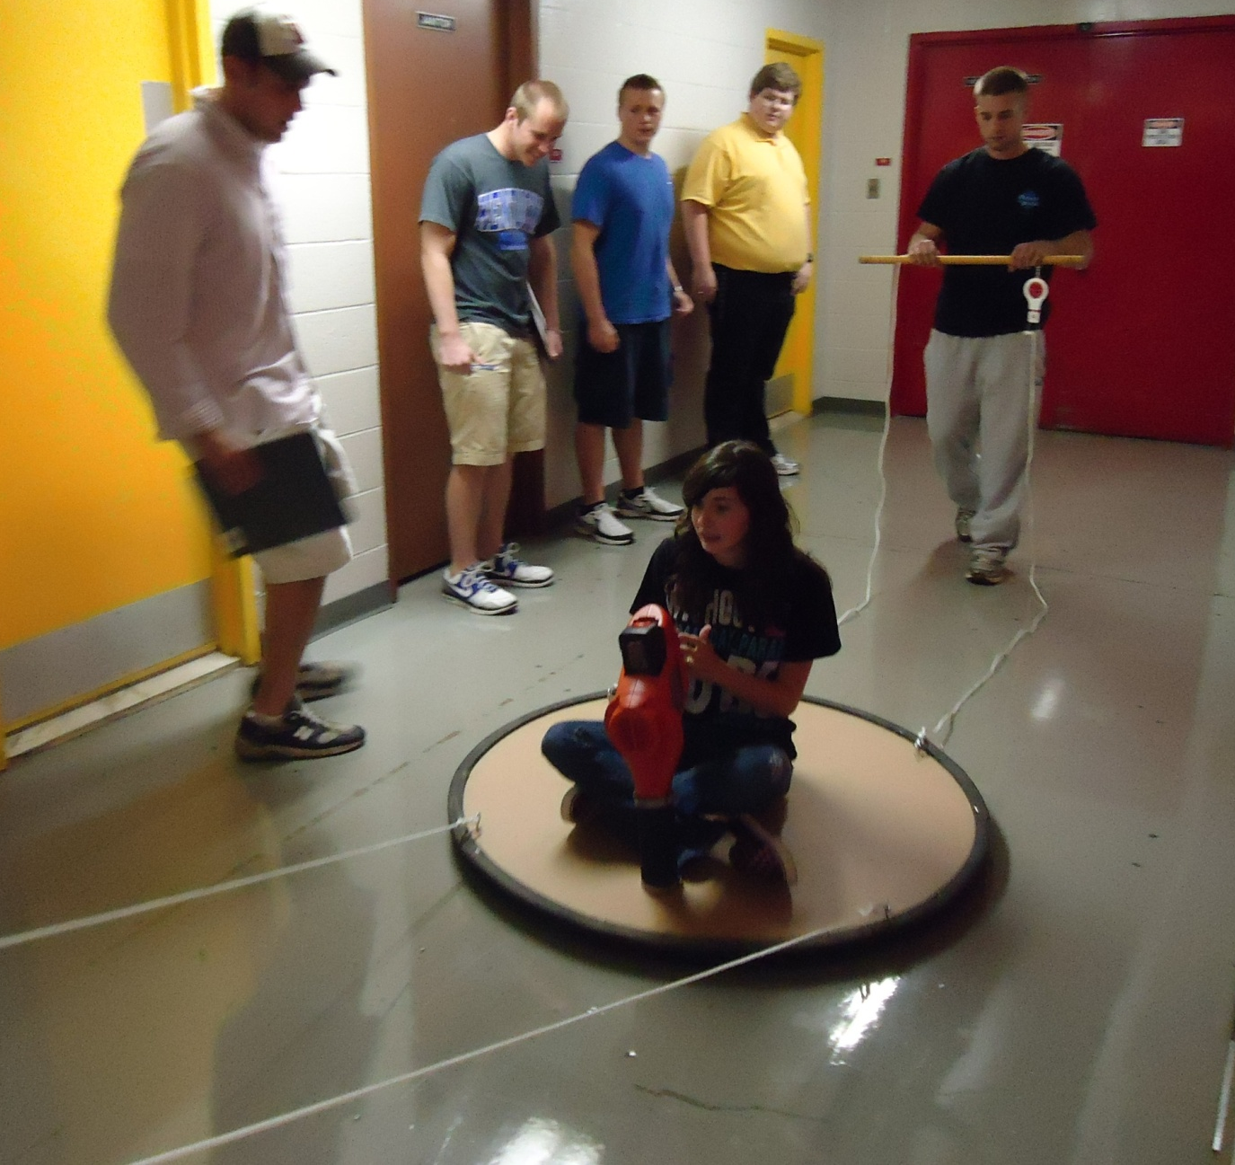
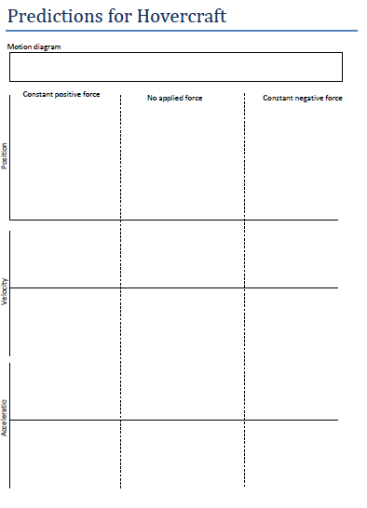


Evaluation of a Multiple Goal Revision of a Physics Laboratory
Scott W. Bonham, Doug L. Harper,, Lance Pauley
Physics and Astronomy,, Western Kentucky University
Contact: Scott.Bonham@wku.edu
Abstract: Physics laboratories can address a variety of goals, such as learning measurement techniques, developing conceptual understanding, designing experiments, analyzing data, reporting results, and others. As our department began revision of our university physics laboratory, we formed a taskforce representing a cross-section of the department to define learning outcomes for the new curriculum. This resulted in a list of eight general learning outcomes: measurement (using both low- and high-tech tools), developing experimental procedures, analyzing data, technical writing, conceptual understanding, uncertainty and error, team work, and a positive experience. A full pilot was run in Spring 2012 with three experimental sections and two control sections. Data was collected using the Force and Motion Conceptual Evaluation, a self-efficacy survey, and performance on the laboratory final. Data from the pilot shows possible gains in conceptual understanding, differences in a few skills directly related to certain laboratory activities, and improvement in technical writing ability as measured by both a writing sample and student perception.
Learning Objectives:
A taskforce consisting of four faculty members and an instructor who regularly teach the first semester lecture and/or laboratory sections of first semester physics meet and came up with the following learning objectives.
Measure physical quantities using tools from simple scales to sophisticated data acquisition (LabVIEW) employing proper procedures for the given tool and keeping good records.
Develop experimental procedures to carry out an investigation to test a hypothesis.
Identify the appropriate methods (e.g. equations, diagrams) for analyzing data and carry it out correctly, including producing and fitting graphs.
Write technical reports that use appropriate language and are structured in typical format, such as including an abstract, introduction, experiment/procedures, data/results and conclusion.
Demonstrate improved conceptual under-standing of foundational physics concepts.
Identify, minimize and quantify uncertainty in measurements, estimate uncertainties in cal-culated results, and compare with other results.
Effectively function in teams to accomplish different tasks.
Report having a positive learning experience in the course.
Elements of Revised Curriculum
Evaluation of the Spring 2012 Pilot
Three sections were run using the revised curriculum, and two sections using the previous curriculum. Each section had a different instructor, all with previous experience teaching the laboratory.
Measurement skills
Both computerized and non-computerized measurements
Data acquisition uses program written using LabVIEW.
  Define and calibrate each sensor channel used.
  Define derived and calculated channels (e.g. velocity and kinetic energy).
  Define statistical values to collect for different channels.
  Uses custom designed interface box.
Learning of skills scaffolded by using configuration files that initially carried out many of steps, progressively reduced until students carry out all.
Experimental procedures
Students provided general goals, guiding questions, but not step-by-step instructions.
Pre-lab questions ensure students are familiar with basic concepts and think about design questions before coming to lab session.
Many labs designed to have more than one way to set up experiment/collect data.
Amount of guidance progressively reduced as semester progresses.
Instructor and undergraduate Learning Assistant provide guidance as needed.
Pre/post conceptual gains on FMCE assessment
Measure | Experiment | Control | Historical
Pretest | 14.6 | 11.3 | 13.7
Posttest | 22.3 | 16.6 | 21.3
Hake gain | 24% | 15% | 23%
Effect size | 0.64 | 0.70 | 0.63
N | 29 | 16 | 115
Force and Motion Conceptual Evaluation taken first meeting of course and last or next to last meeting. Did not count toward grade. Results hint that there might be a difference, but not large enough to be sure. Not surprising, as lecture is where conceptual learning is primarily expected to be learned. Historical includes the previous two years. Some of the historical sections included approaches such as Peer Instruction.
Friction apparatus in inclined and in horizontal configurations
Self efficacy survey
Screen shot, air track and interface box for energy on inclined plane lab.
Given in class at beginning of period during the 10th week of semester.
No differences observed by gender or major.
Average number of previous science labs taken was greater in control sections (2.4 vs 1.7). When controlled for by using linear regression, only question with significant difference was that on writing; coefficient significant with p < 0.005.
Data analysis
Learn to use Igor Pro for plotting data and carrying out fitting.
Amount of pre-programmed script and guidance progressively reduced as semester progresses.
Instructor and undergraduate Learning Assistant provide guidance as needed.
Conceptual understanding
Some pre-lab questions focus on conceptual understanding.
Part of the force and motion labs have students make predictions and qualitatively interpreting graphs and motion diagrams.
  Position and velocity graphs walking in front of motion sensor.
  Compare velocity and acceleration graphs speeding up/slowing down in different directions
Technical writing
Subtractive grading rubric provided to students.
First week students use course grading rubric to grade a good example and a poor example report.
Each week a different section of report discussed.
Students add one section to their reports each week.
Qualitatively determining acceleration due to a constant net force on a hovercraft.
  Acceleration of basketball rising and falling.
  Acceleration of a hovercraft pulled with a constant force.
Titles and abstracts of good and poor example reports.
Performance on common laboratory final exam
Tasks:
Perform a calibration of a motion sensor.
Measure the lengths of a set of rods with Vernier calipers and determining the average and standard error.
Graph, properly format and perform linear fit on supplied position and velocity data
Determine the spring constant of a spring and predict the stretch with a untested weight.
Write an abstract for a provided sample report
Performance on selected lab final tasks
Measure | Experiment | Control
Average precision measured with Vernier calipers (log) | 0.007 | 0.03
% completely labeled graphs (% including missing graph title) | 38% (93%) | 78% (81%)
Length of abstract (lines) | 7.6 | 7.7
Log-average of error motion sensor calibration task (cm) | 0.23 | 0.23
Acknowledgements
  National Science Foundation under grants DUE-0942293 and DUE-9850632
  Western Kentucky University Department of Physics and Astronomy
Keith Andrew
Thomas Bohuski
Vladimir Dobrokhotov
Steven Gibson
Prediction sheet for hovercraft activity.
Changes in Preparation for Fall 2012
For students
Overly long activities revised to be more focused.
Complete, printed lab manual with extensive reference section.
Improved scaffolding of learning software and graphing procedures.
Team work self-evaluation exercises.
For instructors
Complete set of instructor notes.
More formal professional development for instructors and learning assistants.
Complete Blackboard package to unpack in individual laboratory sections.
William Garcia
Jessica Simpson
Samuel White

