Slide 1




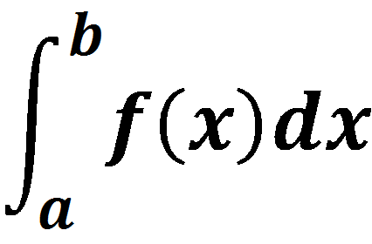
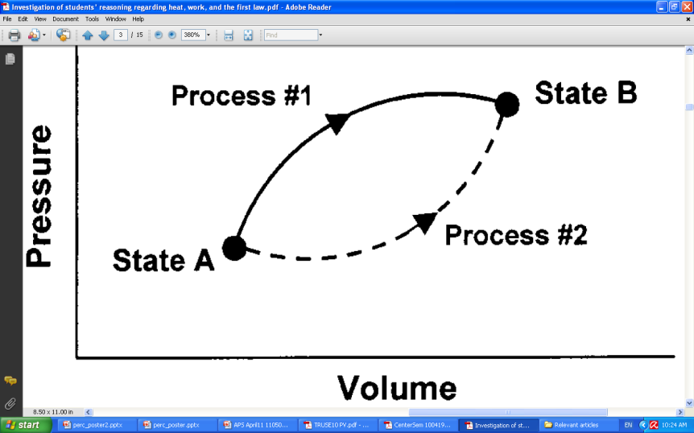
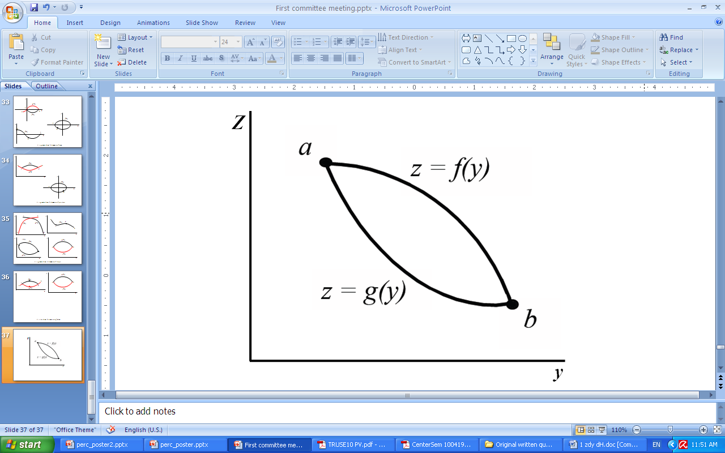
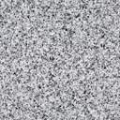
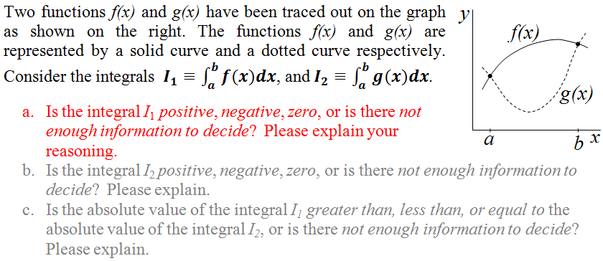
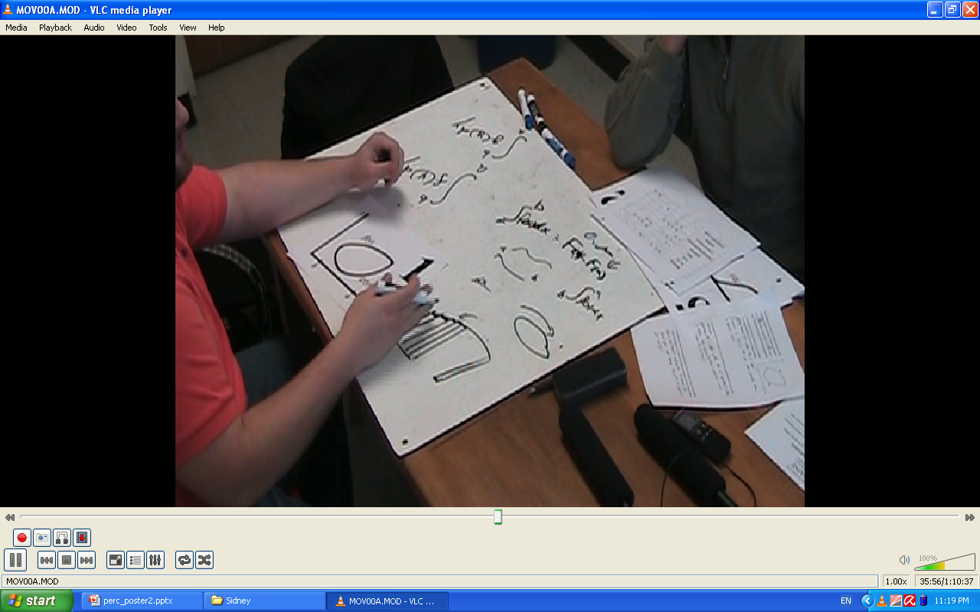
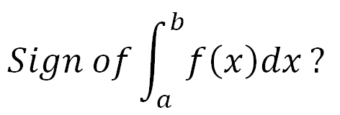
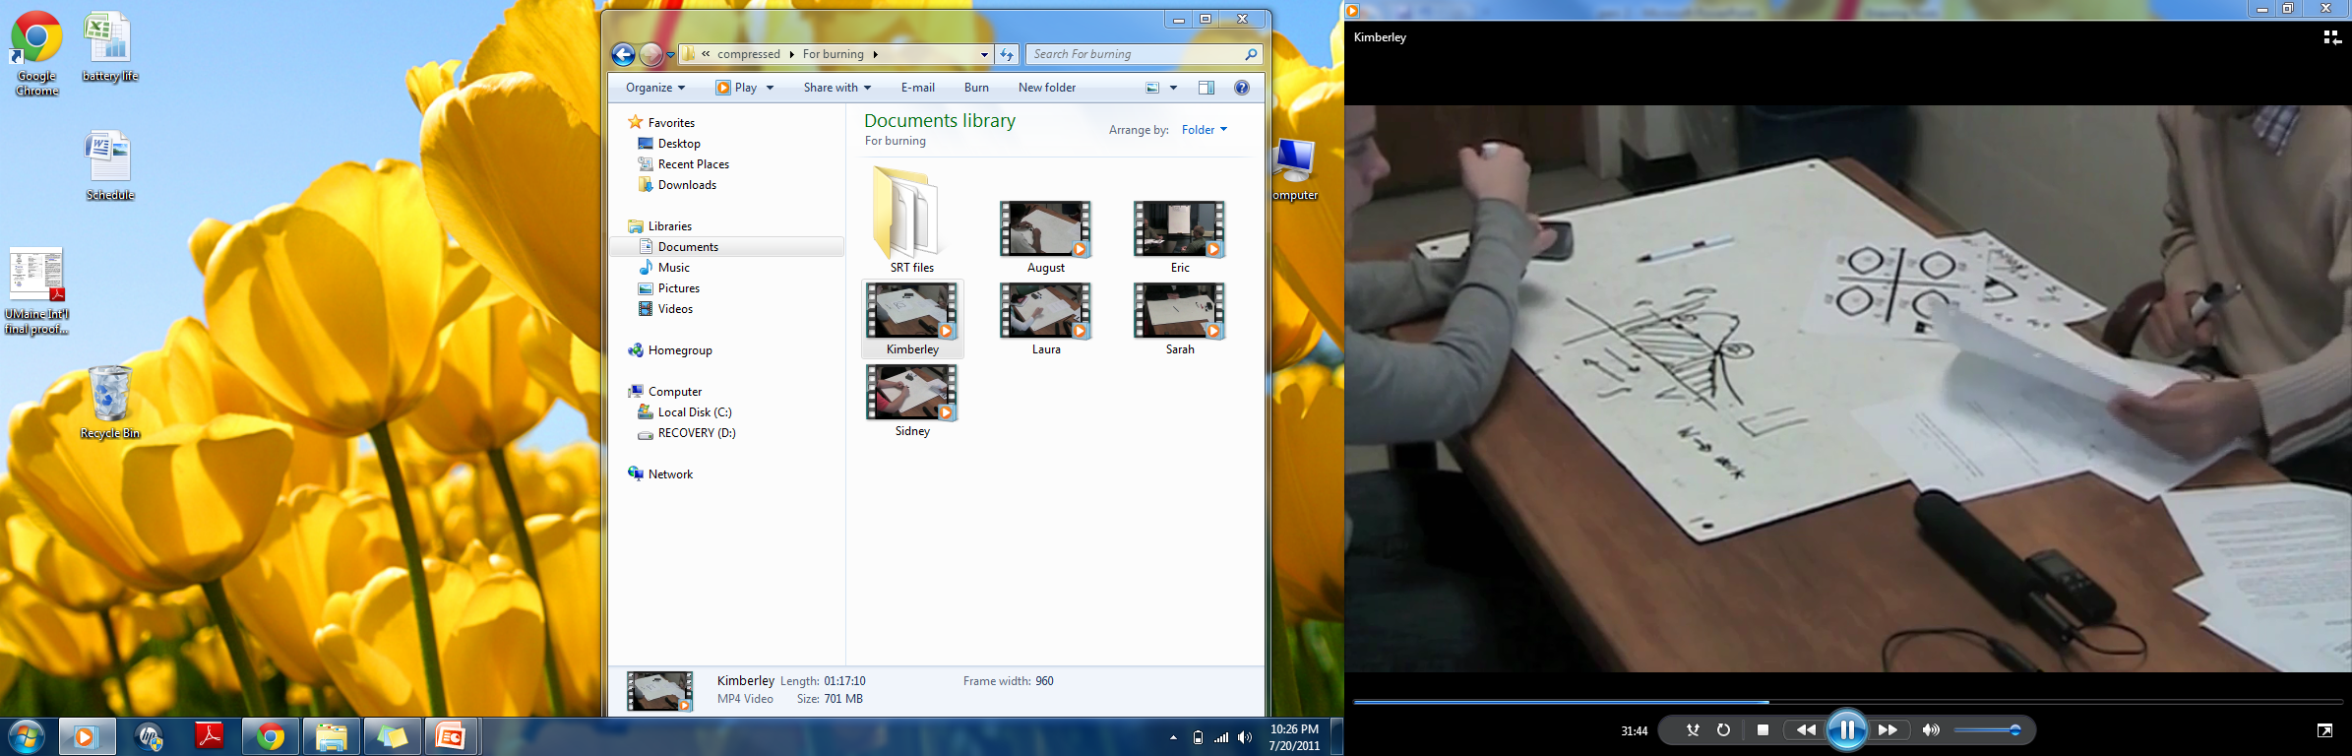
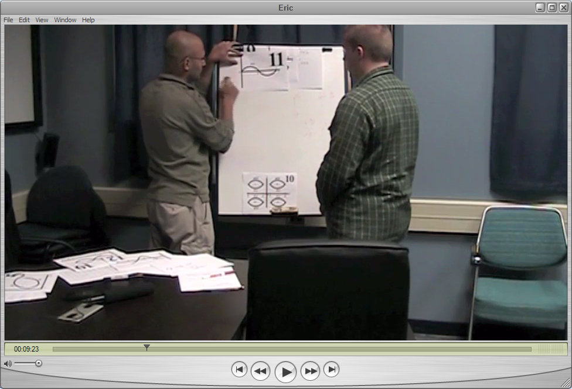
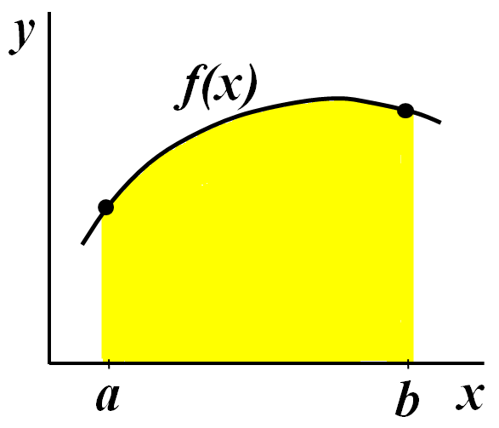
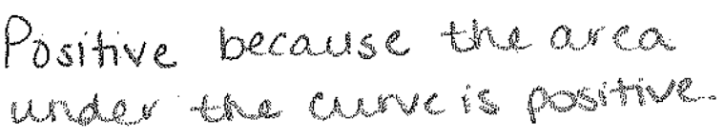
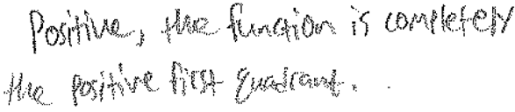
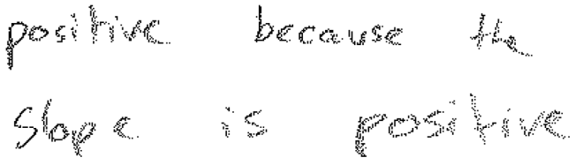
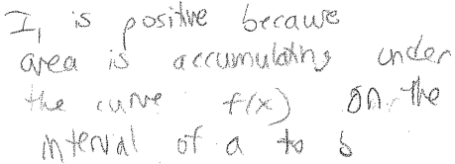
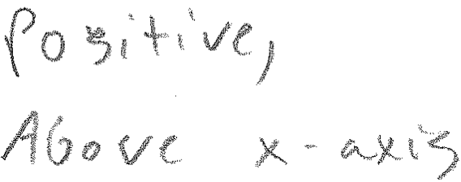
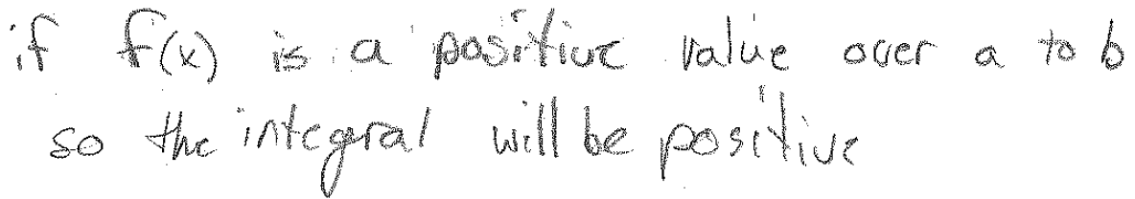
Student Interpretation of the Signs of Definite Integrals
Using Graphical Representations
Rabindra R. Bajracharya, Thomas M. Wemyss, and John R. Thompson
Department of Physics and Astronomy and Center for Research in STEM Education
Research Supported in part by
National Science Foundation grants
DUE 0817282, DUE 0837214
Maine Academic Prominence Initiative
Previous research on student difficulties with definite integrals
y
Physics question
Research methodology and instruments
Students fail to recognize integrals as limit of Riemann sum (Orton, 1983)
Students often show difficulty interpreting “negative area” (Bezuidenhout and Olivier, 2000)
Geometric intuitions about integration, such as area under curve, could limit applicability of conception of integrals (Thompson & Silverman, 2008)
Students often depend on the physical characteristics of graph when interpreting kinematics graphs (Beichner, 1994)
Students use physics context to reason about calculus tasks (Marrongelle, 2004)
Area under the curve concept is not sufficient to learn definite integral (Sealey 2006)
Students fail to apply area under a curve concept in solving physics problems (Nguyen & Rebello, 2011)
Varied representational features to probe students’ interpretation of the signs of definite integrals
Written Survey* was administered in
2nd-semester calculus-based introductory physics (PHY)
multivariable calculus (MAT)
Individual Interviews** were conducted
with physics students – same population as for written survey
for 40-60 minutes in semi-structured think-aloud format
* The written surveys were administered at the end of semester after all relevant instruction
  * About ¼ of the survey population were enrolled in both PHY and MAT
  ** The interviews were audio and video taped and later on transcribed for detail analysis
a
b
x
Mathematical Concepts
Definite
Integral
Graphical Representation
Meltzer AJP (2004)
Physics Concepts
Pollock et al. (2007)
y
f(x)
a
g(x)
x
Physics-less physics question
b
Analogous math version
Written Survey
[N(PHY) = 97, N(MAT) = 97]
Interviews to Probe Student Reasoning about Negative Integrals using Area [N = 8]
2
Simon: unstable reasoning
Technically, I think it should be positive, technically, in my mind, I think it should be positive because either I can integrate from this way [moving his hand from left to right across the diagram] or I can integrate from this way [moving his hand from right to left], you know?
Initial (Written) Question
1
Only math reasoning No physics reasoning
y
The function evaluated at a is gonna be a smaller value than the function evaluated at b, you’re gonna get a negative value.
f(x)
4
Area reasoning + Riemann sum
(neglecting the sign of dx)
Use of Fundamental
Theorem of Calculus (incorrectly)
I feel that it should be positive because, technically it shouldn’t matter how you count these together, right? … If you counted from this way [moving his hand from right to left across the diagram] or you counted this way [moving his hand from left to right] and you keep the dx the same, you should find the same area, right?
3
g(x)
If your last is then larger than your… is smaller than your first, then I would think you'd get a negative value.
a
b
x
Simon
1
Abby: using physics context
Use of physics context
2
Student uses area reasoning
… finding the area underneath this graph is useful because it gives the work done in that process and I can know by if the volume gets bigger, like in this process it’s going to be like positive work…
... and then this way [right-to-left] it’s going to be negative work because it’s compressing and so, like that’s how I know which direction to go in is by like an intuitive knowledge of what I am doing with this integral.
Reasoning for “Positive” responses
Follow-up with negative integral (right-to-left)
y
Invoking physics concept to reason about
positive integral (initial question)
Abby
Invoking physics concept to reason about negative integral (“reverse direction”)
f(x)
1
Freddie: inconsistent reasoning
Sign of the integral of negative function towards increasing x
It depends on what you're doing – if you're wanting to find the area, then I would say the area is always gonna be positive, regardless. But, when you do out the math, this looks like it would give you a negative number.
2
g(x)
In order to get negative area it is not... conceptually, looking at like a plot of land, it would be an impossibility. However, we are looking at something like a voltage; voltages can very easily go negative because we only have them in reference to what we called to be ground.
More than 80% of students in both Physics and Calculus classes correctly identified the sign of definite integral.
A chi-squared test (at α = 0.05) yields inconclusive significance for any difference in distribution of reasoning between physics and calculus classes.
b
a
x
Freddie
Area reasoning conflicting with
Fundamental Theorem of Calculus result
Using physics concept to reason about “negative area”
Physics reasoning to justify negative area
Student reasoning for the positive sign
y
f(x)
y
f(x)
Summary: Student reasoning about the signs of definite integrals
References
Based on the results of our written surveys, we categorized students’ lines of reasoning:
Area under the curve Position of the function Shape of the curve
The interview results indicate that, for graphical representations of integrals, students
use varied lines of reasoning to try and make sense of “backwards” integrals
have difficulty interpreting “backwards” integrals using mathematical reasoning
Reasoning using (geometric) area conflicts with symbolic reasoning (i.e., using FTC)
overlook the importance of the sign of dx in determining the sign of an integral
use physics contexts to successfully make sense of negative (and positive) integrals
A. Orton, Educational Studies in Mathematics 14(1) (1983)
D. E. Meltzer. Am. J. Phys. 72(11),1432 (2004)
E.B. Pollock et al., 2007 Phys. Educ. Res. Conf., AIP Conf. Proc. 951, 168-171 (2007)
J. Bezuidenhout & A. Olivier, Proc. 24th PME 2, 73-80 (2000)
K. A. Marrongelle, in Social Science and Mathematics 104(6), 258 272 (2004)
P. Thompson & J. Silverman, in Making the connection (MAA), pp. 43-52 (2008)
T. Eisenberg, in The Concept of Function: Aspects of Epistemology and Pedagogy, MAA Notes #25, pp.153-174 (1992)
T. Wemyss, R. R. Bajracharya, J. R. Thompson, & J. F. Wagner, 2011 RUME Proc. (2011, submitted)
V. Sealey, PME-NA Proceedings, 2, 46-53 (2006)
W.L. Hall, Jr., Proceedings of the 13th Annual Conference on RUME, MAA (2010)
D.H. Nguyen & N.S. Rebello, Phys. Rev. ST Phys. Educ. Res., 7(1) (2011)
a
b
x
a
b
x
Area under the curve
Position of the function
Shape of curve
Graphical Representation
Math
Concepts
Some mathematical difficulties may be addressed by including physical context in instruction
(e.g., strengthen math-physics connections (Marrongelle 2004))
?
Acknowledgments
Physics Concepts
We would like to thank Eisso Atzema, George Bernhardt, David Clark, and Robert Franzosa for helping us to collect data in their classes. We would also like thank all the members of the UMaine PERL, especially Donald Mountcastle, for productive discussions.

