Slide 1



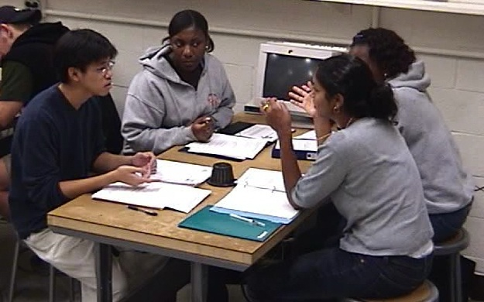


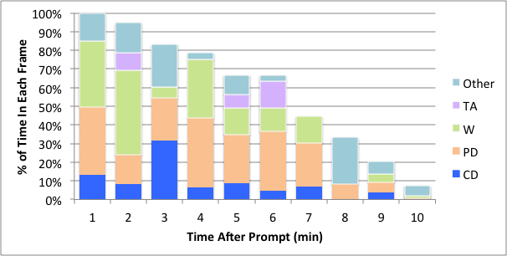
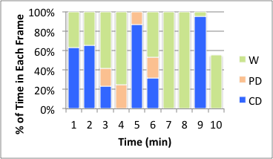
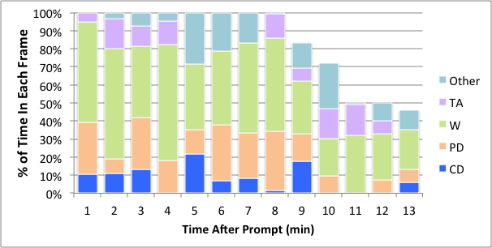
Do Prescribed Prompts Prime Sensemaking During Group Problem-Solving?
Mathew “Sandy” Martinuk, Department of Physics and Astronomy, University of British Columbia, Vancouver BC, martinuk@ubc.ca
Joss Ives, Department of Physics, University of the Fraser Valley, Abbotsford, BC, joss.ives@ufv.ca
Prescribed Problem
Solving Method
Sensemaking In Terms Of
Epistemological Framing
Methods
As recommended in several research-based pedagogies and textbooks^{[1-5]}, we use a prescribed problem-solving strategy in lecture examples as well as weekly small-group problem solving sessions.
Implicit, unspoken expectations (usually shared by an entire group) regarding:
Five Frames^{[9]}
Frame |  | Description
Other / Off-topic | O | Meta-comments, group role negotiations, off-topic discussion
TA Focus | TA | Focus on interacting with Teaching Assistant
Worksheet Focus | W | Focus on writing on worksheet or directing others’ writing
Procedural Discussion | PD | Engaged discussion to figure out how to proceed or what the professor expects
Conceptual Discussion | CD | Engaged discussion to understand meaning of physics.
Students work together on Context-Rich Problems^{[1]} using worksheets that present the problem and then each step with a few reminders and prompts for the contents of that step.^{[6]} Steps 2-6 are mandatory and graded.
What kind of learning activity is this?
How will we learn? What are we aiming for? What knowledge is relevant here? ^{[7,8]}
Audio of N=6 student groups coded for epistemological framing and timing of problem-solving strategy prompts.
 | Step
1. | Interpret the Problem
2. | Identify Relevant Physics
3. | Model: Identify Assumptions and Relationships
4. | Model: Construct a Diagram
5. | Solve the Problem
6. | Error-checking and Sensemaking
“Sensemaking” is operationalized as the frame of “Engaging in Conceptual Discussion”
Results
Aggregate of Frames After The ‘Assumptions’ Prompt
“Best Case” Conceptual Discussion
Percentage of Conceptual Discussion During Problem-Solving
The decrease in total
time is due to student
groups moving on to
the next prompt
The frames after the Assumptions Prompt show the highest average % and the most student groups engaging in Conceptual Discussion. Examination of students’ discourse shows a pattern where they automatically parrot ‘common’ assumptions for the first few minutes and then discuss the sensibility of these or other possible assumptions.
Of course, students working on a quantitative problem can’t spend all of their time in Conceptual Discussion. To develop a benchmark for Conceptual Discussion we identified an episode where a well-functioning group (#4) went through a sequence of starting a task, discussing it conceptually in an engaged collaborative fashion, and recording it. The frames in this episode are illustrated here.
Group #: | 1 | 2 | 3 | 4 | 5 | 6 | Overall Average* | # of groups engaging in CD
1. Interpret | 41% | n/a | 13% | 10% | - | - | 11% | 3
2. Relevant Physics | - | 7% | - | - | - | 2% | 2% | 2
3. Assumptions | 10% | 6% | 18% | 14% | 10% | 19% | 13% | 6
4. Diagram | - | - | n/a | - | 4% | 6% | 4% | 2
5. Solve | - | - | - | 38% | 5% | 10% | 8% | 3
6. Error-Checking | - | - | 4% | 7% | - | 24% | 5% | 3
Overall Average* | 4% | 2% | 9% | 14% | 4% | 9%
Aggregate of Frames After The ‘Solve’ Prompt
The decrease in total
time is due to student
groups moving on to
the next prompt
The surprisingly high rate of CD after the Solve segment are due to:
one group does very little sensemaking before reaching the solve prompt
several groups engage in spontaneous sensemaking of their results
one group has an ongoing debate over a contentious assumption
The overall ratios are W = 53%; PD = 8%; CD = 38%
*Overall Average indicates the total time spent in the Conceptual Discussion frame over the total time spent in that segment.
Structured Prompts are Not Enough
Assumptions Prompt is Most Effective
Prompts Encourage Worksheet Focus
Conclusions
Even assuming all Conceptual Discussion is the result of the prompts, there is very little CD compared to the best case. For example, the explicit prompt to engage in Error-Checking and Sensemaking elicits only shallow and cursory consideration from most student groups.
These results suggests that prescribed problem-solving strategies alone are ineffective at prompting sensemaking.
The most successful prompt is the explicit requirement to state modeling assumptions, which prompted conceptual discussion from every group studied. The data also shows a significant peak in Conceptual Discussion shortly after the prompt which fits the notion that a prompt’s influence is highest shortly after it is encountered.
Students’ discourse suggests they perceive prompts as a list of conditions to be satisfied for marks. Thus, the prompts encourage mark-getting rather than sense-making. The Assumptions prompt is successful at prompting sensemaking only because it implicitly requires reconciliation between formal physics and everyday intuition.
Our results suggest that overall, using prescribed prompts on group worksheets does not promote students’ sensemaking, and may actually inhibit it. In order to encourage sensemaking, we suggest focusing on assessment rubrics that reward overall coherence, rather than piece-wise satisfaction of individual step requirements
End Notes:
P. Heller, R. Keith, and S. Anderson, Am. J. Phys 60, 627-636 (1992).
R. Teodorescu, Ph.D. dissertation, The George Washington University, 2009.
A. van Heuvelen, Am. J. Phys 59, 898-907 (1991).
R. Knight, Physics for Scientists and Engineers: A Strategic Approach (Addison Wesley, Boston, 2008)
H. Young, R. Freedman, and L. Ford, University Physics with Modern Physics (Addison Wesley, Boston, 2008).
The students are also introduced to the unfamiliar steps in the problem solving strategy with a series of workshops at the beginning of term.
D. Tannen, Framing in Discourse (Oxford University Press, New York, 1993).
R. Scherr and D. Hammer, Cognition and Instruction, 27, 147-174 (2009).
The authors have achieved 80% Inter-Rater Reliability using this scheme. In addition all instances of CD were discussed by both authors, who reached consensus.
The authors gratefully acknowledge the support of the UBC Physics Department and the Carl Wieman Science Education Initiative, and the University of the Fraser Valley.

