Slide 1


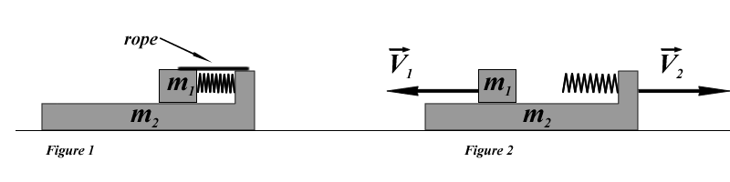
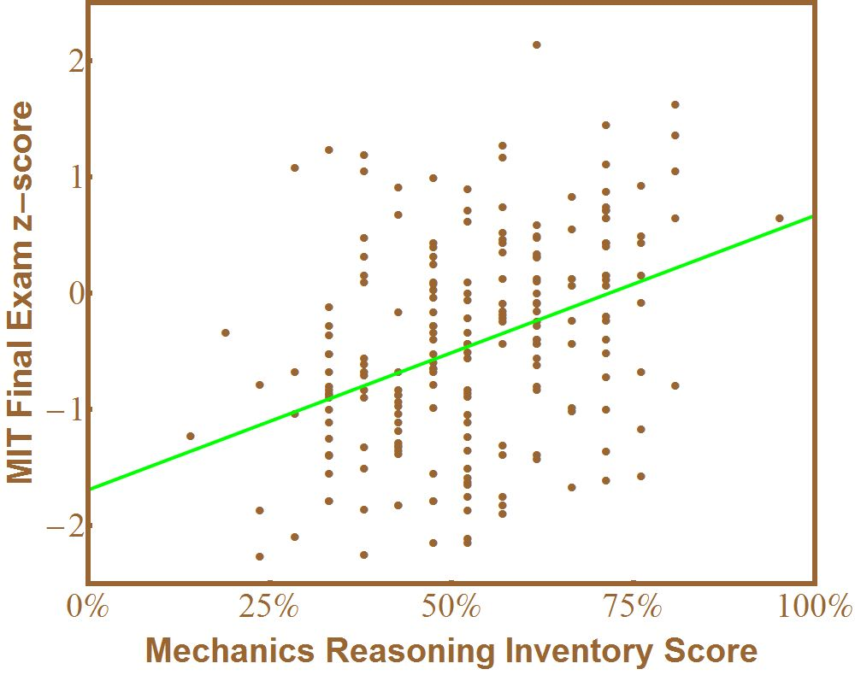
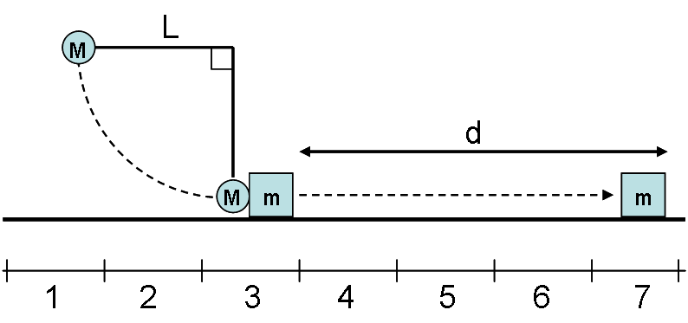


Free-Response Administration of a Mechanics Reasoning Inventory
Andrew Pawl¹, Analia Barrantes², Carolin Cardamone², Saif Rayyan², David E. Pritchard²
pawla@uwplatt.edu analiab@mit.edu cnc@mit.edu srayyan@mit.edu dpritch@mit.edu
¹Dept. of Chem. & Engineering Physics, University of Wisconsin-Platteville, Platteville, WI
²RELATE Group, Department of Physics, Massachusetts Institute of Technology, Cambridge, MA
http://RELATE.mit.edu
See the full Inventory at:
www.uwplatt.edu/~pawla/MRI
Goal
Free Response Administration
Implications of Free-Response Results
Develop and validate an inventory measuring the understanding of conceptual strategies required for effective problem solving in physics.
40 students enrolled in calculus-based introductory mechanics at the University of Wisconsin-Platteville took a free-response form of the inventory during the final week of classes for the Spring 2011 semester. They were offered $10 for 50 minutes of work on the questions. Not all students completed the full inventory, but questions were given in random order so each was completed by at least 31 students.
Students Understand the Questions
The most important finding is that the students interpreted the questions as intended by the authors. The one exception is the decomposition problems, where 15 out of 38 students hurried through the instructions and failed to write out a decomposition in terms of the numbered intervals shown in the figures. This is not a concern on the multiple-choice form of the inventory, however. Below, we outline some findings that are cause for concern.
Approach
Experts must go beyond understanding the definition of physical principles and the procedural application of the principles in familiar situations. They must be able to synthesize these definitions and procedures in order to surmise whether a given principle applies in unfamiliar situations. This level of understanding has been called “strategic knowledge” [1].
Our inventory explicitly tests strategic knowledge in the domain of Newtonian mechanics. Our approach is to focus on a small number of conceptually rich problems to deeply probe student understanding of the applicability and non-applicability of the fundamental principles of mechanics.
Full “Lawson Format” is Important
Lawson’s Test of Scientific Reasoning employs a two-question format where students are asked to make a claim and then asked to justify the claim, illustrated in questions 1-4 below. We sometimes employed a “modified” format where the question makes the claim and the student is asked to justify it. The difference is illustrated by comparing questions 3&4 to question 8. Results from multiple-choice administrations of the inventory imply that the full format is more effective, and the free response study confirms this. MIT students significantly outperformed UW-Platteville students on question 3, (full format for both) but significantly underperformed them on question 8, where the written study used a full format but the multiple-choice question is modified. Also, over 40% of students answering question 13 in free response format felt that the forces were not equal, a misconception that we failed to probe in the “modified” multiple choice format.
Questions 1-4
friction
No friction
1.) Which of the following statements describes the linear momentum of the block-box-spring system during the time interval that starts when the rope is cut, and ends when the box is moving with speed V₁ and the block is moving with V₂?
a.) The linear momentum of the block-box-spring system must be conserved.
b.) The linear momentum of the block-box-spring system is not conserved.
c.) The linear momentum of the block-box-spring system is conserved only when m₁ = m₂.
2.) My answer to question 1 is justified because:
a.) The sum of all the external forces acting on the block-box-spring system is zero.
b.) The force of the spring is conservative.
c.) Linear momentum is always conserved.
d.) There is friction between the block and the box.
e.) The process is essentially an elastic collision.
3.) Which of the following statements describes the mechanical energy of the block-box-spring system during the time interval that starts when the rope is cut, and ends when the box is moving with speed V₁ and the block is moving with V₂?
a.) The mechanical energy of the block-box-spring system must be conserved.
b.) The mechanical energy of the block-box-spring system is not conserved.
c.) The mechanical energy of the block-box-spring system is only conserved when m₁ = m₂.
4.) My answer to question 3 is justified because:
a.) The sum of all the external forces acting on the block-box-spring system is zero.
b.) The force of the spring is conservative.
c.) Mechanical energy is always conserved.
d.) There is friction between the block and the box.
e.) The process is essentially an elastic collision.
Questions 7 & 8
An astronaut is holding onto a long aluminum antenna attached to a deep-space probe which is floating freely far from any other object. The astronaut is initially at rest, but then begins to climb out along the antenna. The next two questions refer to this situation.
Inspiration
7.) Throughout this process, the linear momentum of the system consisting of the astronaut and the space probe (including the antenna) together is conserved because:
a.) All the forces are internal.
b.) All the forces are conservative.
c.) Linear momentum is always conserved.
d.) The statement is false. Linear momentum is not conserved for this system.
8.) Throughout this process, the mechanical energy of the system consisting of the astronaut plus space probe together is conserved because:
a.) All the forces are internal.
b.) All the forces are conservative.
c.) Mechanical energy of an isolated system is always conserved.
d.) The statement is false. Mechanical energy is not conserved for this system.
To realize our goals we have adopted two specialized question types from existing instruments:
“Because” questions from Lawson’s Classroom test of Scientific Reasoning [2].
Decomposition questions from Van Domelen’s Problem Decomposition Diagnostic [3].
Avoid Jargon
On question 12, which involves an action-reaction pair, only 33% of the written responses that clearly gave the correct reasoning mentioned the 3rd Law and an equal number exhibited confusion about which of the three laws was the action-reaction law. In questions 1-4, where objects are moving along frictionless ground, only 10% of the students mentioned internal or external forces, and an equal number instead discussed the fact that friction would cancel because it acts equally on both blocks. (Interestingly, in the clearly isolated situation of questions 7 and 8, 25% of the written responses discussed the absence of outside or external forces.)
Need for Clearer Correspondence of Justifications
All the decomposition problems use a full “Lawson format” but we went too far in hiding the correspondence of the justifications with the decompositions. Performance is very poor on the multiple-choice version of these questions. 75% of the students who gave the correct written response to problem 20 provided a justification that explicitly had three stages.
Correlation with Final Exam
Correlation r = 0.38 for 206 students
(Differs from zero with p = 1.4x10⁻⁸)
Questions 20 & 21
Questions 12 & 13
20.) The pendulum shown in the figure is released from rest when the string is perfectly horizontal and swings down to hit the box (mass m > M). The pendulum string is vertical when the collision occurs. The pendulum stops after it hits the box, and the box slides a distance d along a rough horizontal surface until it stops. You are asked to find the coefficient of kinetic friction between the box and the surface using the quantities described in the problem plus the gravitational acceleration g. What is the most appropriate way to decompose this problem?
a.) One problem: 1-7
b.) Two sub-problems: 1-3, 3-7
c.) Three sub-problems: 1-3, 3, 3-7
A person is trying to move a very heavy safe by pushing it along the ground. The force applied by the person to the safe is perfectly horizontal. Neither the person nor the safe is moving. The following four questions refer to this situation.
12.) The force applied by the person to the safe and the force applied by the safe to the person are:
a.) Equal in size because of Newton’s Second Law applied to the person.
b.) Equal in size because of Newton’s Second Law applied to the safe.
c.) Equal in size because of Newton’s Second Law applied to the safe plus the person as a single system.
d.) Equal in size because of Newton’s Third Law.
13.) The friction force acting on the person from the ground and the force on the person from the safe are:
a.) Equal in size because of Newton’s Second Law applied to the person.
b.) Equal in size because of Newton’s Second Law applied to the safe.
c.) Equal in size because of Newton’s Second Law applied to the safe plus the person as a single system.
d.) Equal in size because of Newton’s Third Law.
21.) My answer to question 20 is justified because:
a.) The work done by the collision forces is unknown.
b.) Mechanical energy is conserved throughout.
c.) Mechanical energy is not conserved when the block is sliding.
d.) The collision is elastic.
y=0.024x-1.69
References
[1] W.J. Gerace, “Problem Solving and Conceptual Understanding”, PERC 2001.
[2] A.E. Lawson, J. Res. Sci. Teach. 15, 11-24 (1978).
[3] D. Van Domelen, “The Development of the Problem Decomposition Diagnostic”,
Ph.D. Thesis, Ohio State University (2000).
Acknowledgments
Development of the inventory was supported by PHY-
0757931 and DUE-1044294 from the NSF and 1-RC1-
RR028302-01 from the NIH. The free-response study
was funded by a Scholarly Activity Improvement Fund grant from UW-Platteville.
The authors thank D. Caballero for administering the inventory at Georgia Tech.

