Slide 1
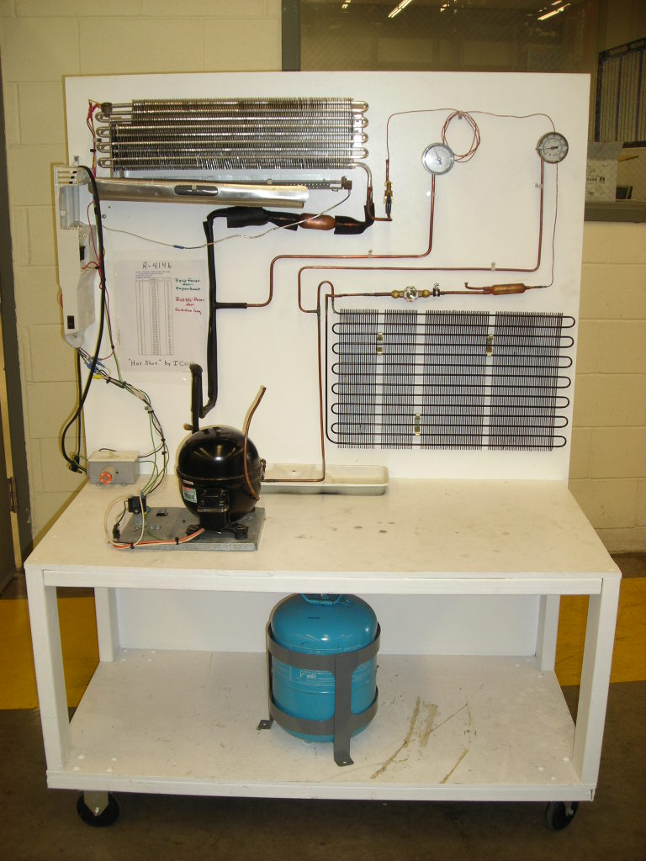
Differentiation of Energy Concepts Through Speech and Gesture in Interaction
Hunter G. Close¹ and Rachel E.Scherr²
¹Department of Physics, Texas State University – San Marcos, ²Department of Physics, Seattle Pacific University
THEORETICAL PERSPECTIVE
Differentiation & Integration in Conceptual Development^{[1]}
Gesture as a Learning Tool in Interaction^{[2,3]}
Gesture is ubiquitous, flexible, spatial, and coupled to cognition.
Conceptual differentiation and integration might be indicated by and facilitated by the differentiation and integration of symbolic motor action (speech, gesture, and any other actions that stand for something).
MOLECULES EPISODE
We analyze interactions in a group of teachers in a 21-second video episode. Twelve were present and five spoke. We analyze the actions of three teachers: Donna, Beth, and Mark.
At the beginning of the episode, the teachers have observed that when the refrigerant in the evaporator receives energy from the warm contents of the refrigerator, the effect is not to raise the temperature of the refrigerant, but to change some of it from liquid to gas. Here they are discussing how to refer to the form of energy increasing in the refrigerant.
Coherent States of Conceptual Differentiation
Mark and Donna show in multiple ways their differentiated concepts kinetic (moving from here to there) and configurational (here or there).
Beth shows her undifferentiated concept scaling (getting bigger/smaller).
Scaling Kinetic Configurational
Is it really [different]? Thermal It’s different from thermal
Molecules move way more Aren’t moving faster Moved farther apart
“Cap” hand shape “Fist” hand shape “Bracket” hand shape
Expanding motion Shaking motion Bouncing motion
Absence of kinetic, potential Vibrating → kinetic Positions → potential
“Shaking fists” and “bouncing brackets” gestures differentiate real dynamic evolution of the system in time (kinetic) from a re-placing of the system with new initial conditions (configurational).
“Expanding caps” gesture moves simply, smoothly, and linearly outward and does not make this distinction.
Undifferentiated concept motion is differentiated into velocity and acceleration
Differentiated concepts are coordinated in integrated structure to yield new knowledge about trajectory
Actions in the Molecules Episode
DATA SOURCES AND METHODS
Donna: It's different from thermal
Beth: Is it really? I mean
Jack: It really, it could be a, it's, it's
Donna: It's different than average kinetic energy of the molecules.
Mark: Yeah!
Sarah: Right.
Donna: When you're changing phase, that's different from the average thermal energy.
Beth: Because it
Sarah: It should be different.
Beth: When you're changing phase, you're making the molecules either move way more
Mark: They're moved farther apart but the molecules aren't moving faster.
Beth: Farther apart.
Donna: You're changing the positions but they might be vibrating the same amount
Beth: Oh...Oh, I see what you're saying.
Donna: So the average kinetic energy is… could still be the same
Beth: 'Cause it's the same, it's just farther apart.
Donna: It's a change in the potential, because it's a change in the positions.
Tradition: Fine-grained, qualitative, multi-modal interaction analysis^{[4]}
Data: Video records of interactions between learners during an interaction-rich learning situation
Hermeneutic:
Meaning of actions in the situation is given primarily by immediately prior interactive function of any similar actions within the situation
move way more, Beth’s “expanding caps”
Dynamics of Failed Differentiation
In Beth’s response to Mark and Donna,
She does repeat: She does not repeat:
Farther apart Any other special words, especially those associated with the kinetic concept
“Bracket” hand shape “Fist” hand shape
Her own expanding motion Either the bouncing or shaking motions
farther apart, Mark’s “bouncing brackets”
CONTEXT OF LEARNING SITUATION
Energy Course for Teachers
Teachers in this episode were enrolled in the second year of a two-year sequence of intensive summer courses on the learning and teaching of energy^{[5,6]}. Each course lasted ten full days. This episode occurred on the eighth day, after about eight hours (over three days) of intensive small-group-directed study of refrigerators using information from the internet.
Their challenge: Develop a narrative of the energy transfers and transformations in a household refrigerator.
Background: Physics of Refrigerators
(6x)
(Both hands,
side-by-side)
moving faster, Mark’s “shaking fists”
Schematic diagram of different states of conceptual differentiation.
Mark and Donna differentiate the concepts kinetic (K) and configurational (C). Beth’s concept scaling (S) fuses (rather than coordinates) elements of kinetic and configurational.
When Mark and Donna observe Beth’s undifferentiated actions, they correct her with differentiated actions. The ideal result of this correction is that Beth’s concept S will become differentiated into K and C.
The actual result of the correction in this interaction is that Beth’s actions become more like those associated with C, but with no explicit acknowledgement of K.
farther apart, Beth’s “expanding brackets”
(continuous throughout speech)
(Both hands,
shoulder-width)
In a real refrigerator, the refrigerant changes temperature during some parts of the cycle and condenses or evaporates during other parts. This system therefore provides the opportunity for differentiating the energy of changing temperature from that of changing phase.
vibrating the same amount, Donna’s “shaking fists”
CONCLUSIONS
Coherent states of concept differentiation can be seen in interactions.
Interactions across states may not achieve increased differentiation.
Learners can perceive conceptual meaning in others’ actions.
Future instruction might effectively take advantage of links between concepts, actions & perceptions in a more deliberate and explicit effort.
evaporator
“expansion valve”
condenser
it’s just farther apart, Beth’s “expanding caps”
References
1. P. Harder, “Blending and Polarization: Cognition Under Pressure,” J. of Pragmatics 37, 1636-1652 (2005).
2. S. Scopelitis, S. Mehus, R. Stevens, “Made by Hand: Gestural Practices for the Building of Complex Concepts in Face-to-Face, One-on-One Learning Arrangements” in Learning in the Disciplines: Proceedings of the 9th International Conference of the Learning Sciences (ICLS 2010) Volume 1, Full Papers. – edited by Gomez, K., Lyons, L., & Radinsky, J., International Society of the Learning Sciences: Chicago IL, (2010).
3. R. E. Scherr, “Gesture Analysis for Physics Education Researchers,” Phys. Rev. Spec. Topics – Phys. Educ. Res. 4, 1-9 (2008).
4. B. Jordan & A. Henderson, J. of the Learning Sciences 4(1), 39-103 (1995).
5. R. E. Scherr et al., ““Energy Theater”: Using the body symbolically to understand energy,” in 2010 Physics Education Research Conference Proceedings, edited by C. Singh, M. Sabella, & S. Rebello, Melville, NY: AIP Press (2010).
H.G. Close et al., “Using the Algebra Project method to regiment discourse in an energy course for teachers,” in Singh, Sabella, & Rebello, op. cit.
Diagrams of hands are provided by http://etc.usf.edu/clipart/sitemap/hands.php
compressor
(Bounce in
and out 3x)
Photo courtesy of Renton Technical College
change in the potential, Donna’s “bouncing fists”

