Slide 1
Uncovering the hidden
curriculum
decisions that shape
Danielle Boyd Harlow
University of California – Santa Barbara
AAPT / PERC Bridging Session, 2010

Slide 2
8th Grade
Self-reported interest in pursuing science at 8th grade is a significant predictor of whether or not a student will be working as a scientist at age 30.
Tai, Lui, Maltese, Fan, 2006
Notes:
Controlling for variables
Science and math achievement
Demographics
Enrollment in advanced classes
Parents’ background
Used National Longitudinal Data

Slide 3
20%
20% of California elementary school teachers report spending more than 60 minutes on science per week.
16% report not teaching science at all.
Dorph, R., Goldstein, D., Lee, S., Lepori, K., Schneider, S., Venkatesan, S, (2007).
Notes:
Dorph, R., Goldstein, D., Lee, S., Lepori, K., Schneider, S., Venkatesan, S, (2007). The status of science education in the Bay Area: Research brief. Lawrence Hall of Science, University of California, Berkeley, California.

Slide 4
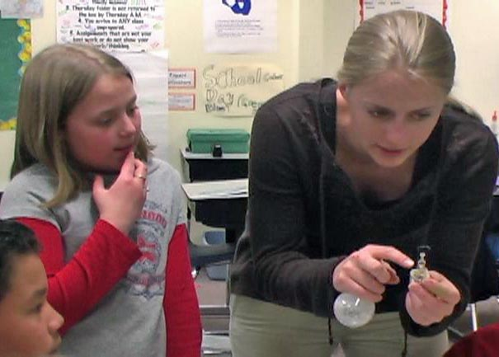
What do I want my undergraduate students
to learn?
What do I want her students to learn?
Notes:
When we teach physics (or methods or whatever else) we know that it’s a good idea to ask what it is that we want our undergraduates to learn. We think about learning objectives and we know that “it’s what the text book” does next is not a good enough reason to teach a topic.
(click)
But I teach elementary school teachers. I teach them physics and I teach them elementary science methods. The question I ask is what I want her students will learn. And today, I’m here to share what I’ve learned from teaching teachers that I think is useful for teaching physics to ALL students.

Slide 5
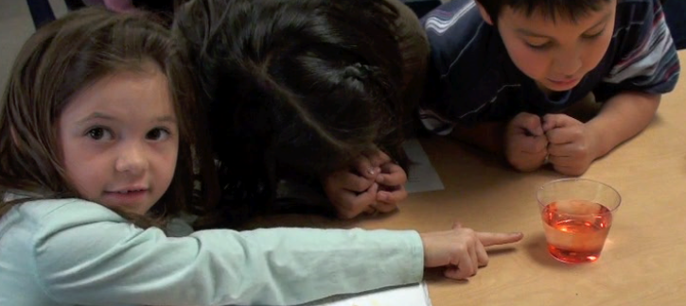
2010
2027
Begin
Elementary School
Graduate College
Today’s children will use technologies we have yet to imagine…
…and face problems
that don’t yet exist
Notes:
This child… (my student’s student)... could graduate from college in the year 2027.
She and her classmates will be living, working, voting, raising children, in 2027 - and beyond.
How do we prepare our students to teach children in ways that will prepare them for the year 2027?
When we’re teaching teachers – this is what we’re doing – we’re preparing people to prepare other people for the year 2027

Slide 6
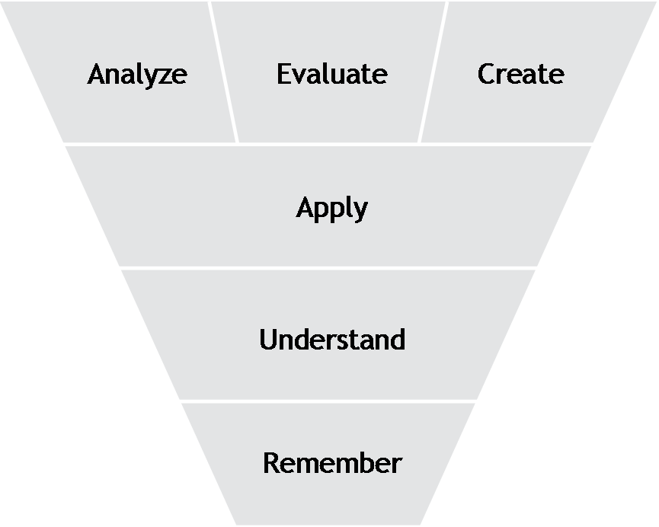
Creativity
We talk about wanting students (of all ages) to learn that creativity is used in science.
But we may not pay enough attention to how children develop creativity
or how to help teachers help students develop it.
or even what it is.
Create
Revised Bloom’s Taxonomy
Anderson, & Krathwohl, 2001
Notes:
We need to help kids learn to be creative. We need to help them learn to take what is given to them and create something new.
This is now at the top of the revised Bloom’s taxonomy (revised by Bloom’s former student).
In science courses that address the nature of science, we work to make sure that students know that creativity is part of the scientific process, but developing creativity is not often an explicit goal of our classes. We do not pay attention to how to help children develop creativity, how to help teachers help children or even what creativity is.
Creativity is something I’m thinking about now. Just playing with it. I’ve started to look into it.
A recent IBM poll of 1,500 CEOs identified creativity as the No. 1 “leadership competency” of the future.
Torrance test of creativity – test has been given since the 1950’s and scores rose consistently (same thing happens with IQ tests) – until 1990 and we’ve been getting less creative every year since then – especially among children in K-6th grade.

Slide 7
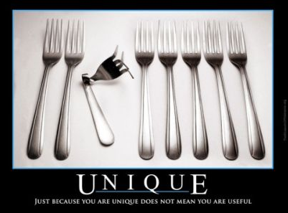
Creativity is ability to produce work that is both novel and appropriate (Sternberg & Lubart, 1999)
Notes:
What is creativity? It is more than just new, novel ideas.
There are many definitions, but a generalized version is that creativity is A PROCESS which results in NOVEL and USEFUL Products.
According to Sternberg and Lubart, creative ideas are both novel AND appropriate. Coming up with these sorts of ideas is hard work.
vs the quality of an experience), the similarities are instructive.

Slide 8
Creativity is ability to produce work that is both novel and appropriate (Sternberg & Lubart, 1999)
Requires domain-specific knowledge and ability to apply that knowledge flexibly.
Frustrated Novice
Adaptive Expert
Innovation
Optimal Adaptability Corridor
Routine Expert
Novice
Efficiency
Schwartz, Bransford, & Sears (2005)
Notes:
In creative endeavors, domain specific knowledge plays an important role.
So let’s look at some work that other people have done.
Schwartz and his colleagues’ work appears in Mestre’s book on transfer. In this model, there are two axes: one represents efficiencies (specialized skills, and knowledge), the other represents the ability to innovate. Adaptive expertise (the ultimate result) is high in both these areas.
A second model is that of Csikszentmihalyi who studies creativity and what he calls “flow” (the ultimate experience). This very similar diagram has skills on the x axis and challenge on the y axis.
While these two models are referring to different things (expertise vs the quality of an experience), the similarities are interesting.

Slide 9
Torrance test of creative thinking (TTCT)
A process of becoming sensitive to problems, deficiencies, gaps in knowledge… identifying the difficulty; searching for solutions; making guesses, or formulating hypotheses; testing and retesting these hypotheses and possibly modifying and retesting them; and finally communicating the results. (Torrance, 1966)
Example Item
Try to improve this toy stuffed rabbit so that it will be more fun to play with.
Scores are correlated to lifetime creative achievement.
Average scores steadily dropping since 1990 (especially among K-6th grade students).
Kim, 2006.
Notes:
Kyung Hee Kim
Fluency, originality, elaboration, resistance to premature closure, abstractness of titles.
Better predictor of lifetime quantity and quality creative achievement than achievement scores, IQ scores, and peer nomination

Slide 10
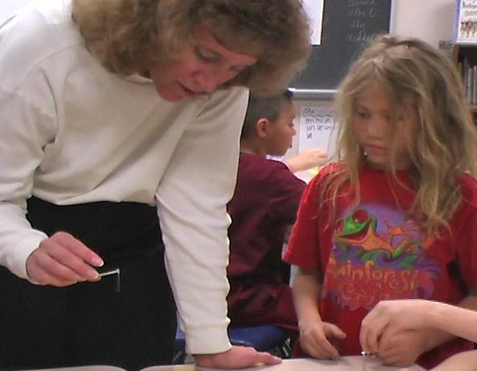
If we want children to be able to develop the skills and habits of mind to create new science knowledge…..
What do teachers
need to do?
How can we help them?
Notes:
This is my big question: If we want children to be able to develop the skills and habits of mind to create new scientific knowledge, what do teachers need to be able to do and how can we (as teacher educators and educational researchers) help them.
This research I am presenting here contributes to this big question by considering a very successful example of a single teaching episode that was actually adapted from a PD course that she took and looking at it carefully to understand how it happened.

Slide 11
Engaging students in developing explanatory models of phenomenon is a powerful instructional strategy.
Adds to scientific expertise
Knowledge of the process
Epistemological understanding
e.g., Russ, Scherr, Hammer, & Mikeska, 2008; Windschitl, & Thompson, 2006; Osborne, Erduran, & Simon, 2004.
Notes:
So let’s return to our students.
We know that “modeling” is an excellent form of instruction. Modeling means that students are attempting to develop an explanation of a phenomenon. It means that they are collecting data, proposing explanations,
Lots of people have said some very important things about modeling and is value.
Modeling can help learners
Develop expertise in scientific content
Develop expertise in practices in building scientific knowledge
Develop epistemological understanding (Lehrer & Schauble 2006) ; Schwartz & White 2005)

Slide 12
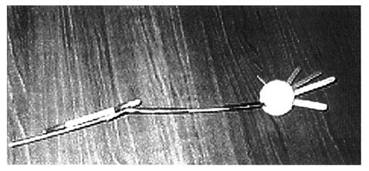
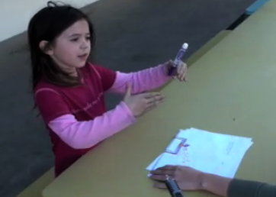
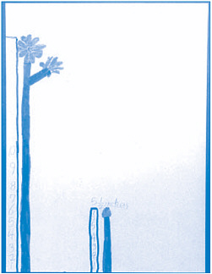
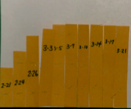
We now know that children are capable of much more sophisticated reasoning than previously thought.
Model of an elbow (Lehrer & Schauble, 1996ab)
Children of all age levels show sophisticated reasoning abilities (NRC, 2008).
1st graders representations of height of plants
Notes:
So why doesn’t this happen more often?
One reason for not teaching through modeling at the early grade levels is the very common idea that children cannot think abstractly.
However, we now know that this idea is just not justified. We now know that children are capable of much more sophisticated reasoning than previously thought. The examples here are of a child’s model of the elbow.
“Note, for instance, the rubber bands that mimic the connective function of ligaments and the wooden dowels that are arranged so that their translation in the vertical plane cannot exceed 180 degrees. Though the search for function is supported by initial resemblance, what counts as resemblance typically changes as children revise their models. For example, attempts to make models exemplify elbow motion often lead to an interest in the way muscles might be arranged” (from Lehrer and Schauble, 1996a, b).

Slide 13
Notes:
This video is of a 2nd grader who was asked to explain her observations of scent traveling throughout a room. She was not unique – many children had equally articulate responses. And she did this without training in how to talk or think about scientific phenomenon. In fact, in her school science was a rare occurrence and when it did happen was text book and worksheet based.

Slide 14
Yet.. Model-based instruction is rarely observed in K-12 classrooms.
Why not?

Slide 15
1. Current state of elementary science education
Science
Math
Social Studies
Arts
Physical Education
School Day
Literacy
2. Teachers have never had the opportunity to learn in ways that help them understand how science knowledge develops.
Notes:
One common explanation is the current state of elementary science education. The demands of NCLB legislation means that, in many schools, the 6 hour school day is divided roughly evenly into 3 hours of math and 3 hours of literacy. This is especially true of struggling schools. Any spare moments at the end of the day might be used for science, but they also need to be used for other content areas that are missing from the curriculum like social studies, the arts, and physical education.

Slide 16
Research on students’ Ideas about forces, electricity, quantum mechanics….
New
Physics Curriculum
Research on students’ ideas about the Nature of Science
Reformed
Physics
Curriculum
Research on
how undergraduates
learn
Evaluations of
other curricula
(what works?)
Research from Physics Education Research, Science Education, Cognitive Science and Psychology contributes to our development of Curriculum and activities

Slide 17
Great
Physics Activity!

Slide 18
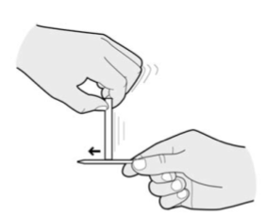
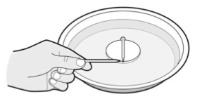
Model of Magnetism (Physics & Everyday Thinking)
“Rubbed Nail” - A nail that has been repeatedly rubbed with a bar magnet.
“Unrubbed Nail” – an ordinary iron nail
Students observe what happens when they bring the two nails together in various combinations.

Slide 19
Common Students’ Ideas: “Charge Separation” Model
N
Before rubbing a nail with a magnet, north and south (or + and -) are randomly arranged in a non-magnetized nail
S
N
S
N
S
N
S
N
S
N
S
N
S
Notes:
Expected initial model among pre-service teachers

Slide 20
Charge Separation Model
“Cut the Nail” Activity
Context (Students’ Ideas)
Teacher Actions
Desired Outcome
S
N
S
N
S
N
S
N
S
N
N
S
S
N
S
N
S
N
S
N
“Tiny Magnets” Model of Magnetism
Notes:
Students are asked to predict what will happen when you “cut the nail” – this activity in combination with other lead to teachers developing a “domain like” model of magnetism. It’s a very powerful learning experience.

Slide 21
Through this activity, what do the undergraduates (future elementary teachers) learn?
Magnetism
How models are developed in science
That they can develop science knowledge
Can they then implement this (or similar strategies) with their elementary students?

Slide 22
It’s a bit of sleight of hand
They don’t know that we know that they will likely propose the charge separation model of magnetism.

Slide 23
Model of Magnetism Activity
Actions
Events
Scientific practice
Observe rubbed nail acts like a magnet
Compare “rubbed” and “unrubbed” nail
Observe Phenomenon
“charge separation model”
Explain what makes a rubbed nail act like a magnet
Explain
(propose model)
Predict that upon cutting a nail in half, 2 monopoles
What will happen when nail is cut in half?
Predict
(based on model)
Observe 2 smaller magnets
Cut nail in half
Test
Domain-like model of magnetism
Explain how cutting the nail results in two nails
Revise
Notes:
I reexamined Ms. Carter’s teaching with the goal of understanding the structures that guided her.
The activity this teacher chose to adapt came from the “model of magnetism activity” from a professional development workshop that used the Physics & Everyday thinking curriculum.
This activity was designed to develop the domain like model of magnetism.
It went as follows. (describe model of magnetism activity)
These “events” (middle column) were the structure that the teacher could “see” – it was the most evident. But this structure was built on an underlying implicit structure. And of course these events were made up of individual actions by the students and teachers [not all actions are included]
These events depended on the actions of the students, particularly the test intended to confront the particular anticipated model.

Slide 24
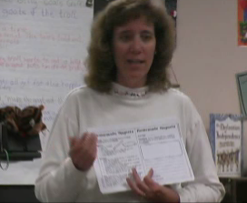
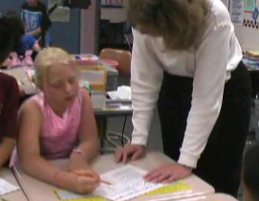
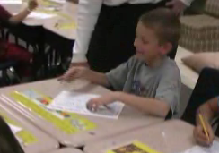
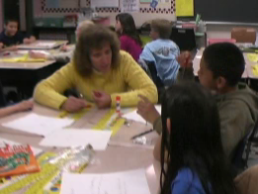
Ms. Carter’s Elementary School Class
Notes:
Video of Ms. Carter doing this same activity in her class. The students propose a dust and activation model. She asks them to rub the dust off. This was a very effective on-the-spot change in the activity.

Slide 25
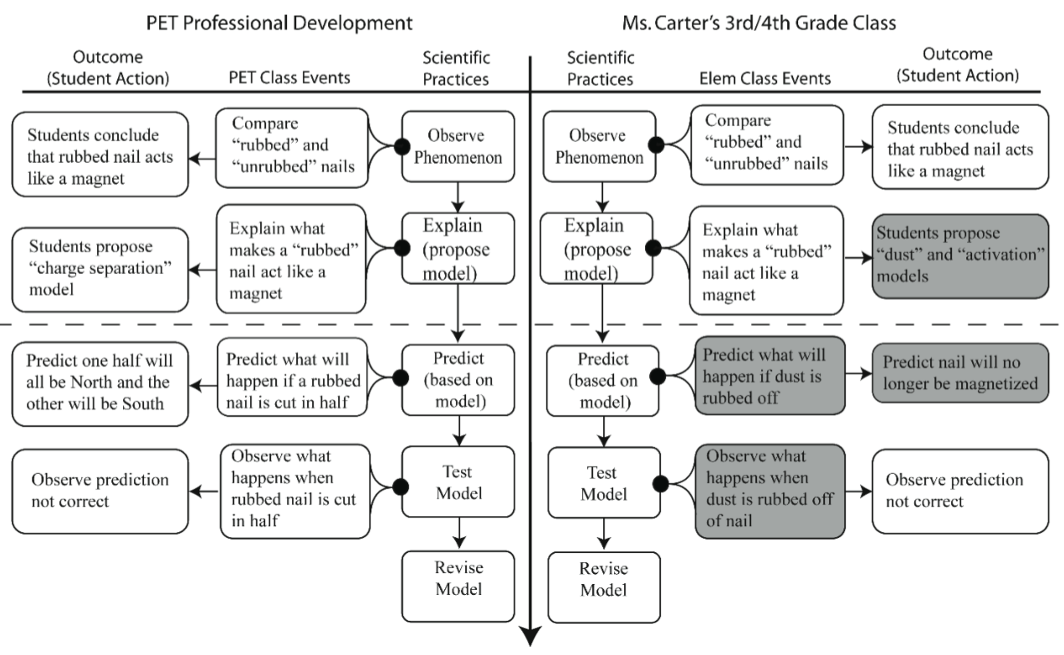
The differences at the event level were necessary to preserve the similarities at the scientific practice level.
Students propose “dust” and “activation” models
Predict what will happen when dust is rubbed off
Students predict nail will no longer be magnetized
Observe what happens when dust is rubbed off
Same
Different
Notes:
Explain what she actually did.

Slide 26
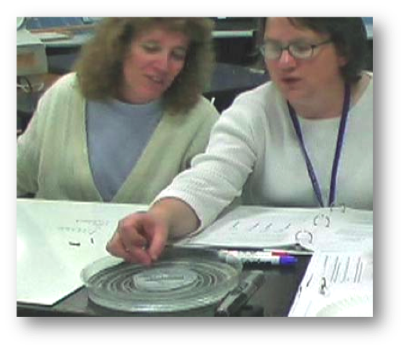
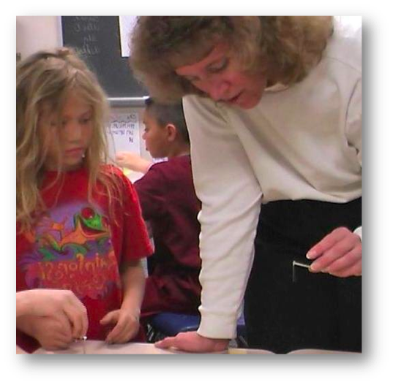
Knowledge
≠
Knowledge
Notes:
This slide shows the same teacher (closest to the middle of the slide in both photos) in two different contexts: Learning about magnetism in PET and teaching magnetism in her 4th grade class. Both contexts are dealing with the same content. But the ideas used may be different in each situation.

Slide 27
Research on students’ Ideas about forces, electricity, quantum mechanics….
New
Physics Curriculum
Research on students’ ideas about the Nature of Science
New
Physics
Curriculum
Research on
how undergraduates
learn
Evaluations of
other curricula
(what works?)
Research from Physics Education Research, Science Education, Cognitive Science and Psychology contributes to our development of curriculum and activities

Slide 28
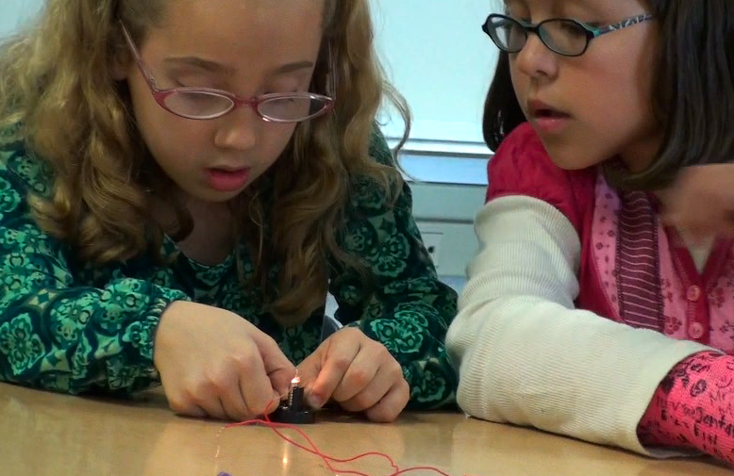
Like students, teachers need domain specific knowledge that they can use flexibly
But to do so, they need to understand the decisions that go into curricular design.

Slide 29
Thank you!
dharlow@education.ucsb.edu
Selected references
Csikszentmihalyi, M. (1997). Creativity: Flow and the psychology of discovery and invention: Harper Perennial
Kim, K. (2006). Can we trust creativity tests: A review of the Torrance Test of Creative Thinking (TTCT). Creativity Research Journal, 18,1,3-14.
National Research Council. (2007). Ready, Set, Science: Putting research to work in K-8 science classrooms. Washington, D.C.: National Academies Press.
Osborne, J., Erduran, S., & Simon, S. (2004). Enhancing the quality of argument in school science. Journal of Research in Science Teaching, 41(10), 994-1020.
Russ, R., Scherr, R., Hammer, D., & Mikeska, J. (2008). Recognizing mechanistic reasoning in student scientific inquiry: a framework for discourse analysis developed from philosophy of science Science Education, 92(3), 499-425.
Sawyer, K. (2004). Creative teaching: collaborative discussion as disciplined improvisation. Educational Researcher, 33(2), 12-30.
Schwartz, D., Bransford, J., & Sears, D. (2005). Efficiency and Innovation in transfer. In J. Mestre (Ed.), Transfer of learning from a modern multidisciplinary perspective (pp. 1-51). Greenwich: Information Age Publishing.
Sternberg, R., & Lubert, T. (1999). The Concept of Creativity: Prospects and Paradigms. In R. Sternberg (Ed.), Handbook of Creativity. Cambridge Cambridge University Press.
Tai,R. et al (2006). Planning Early for a career in science, Science, 312, 1143.
Windschitl, M., & Thompson, J. (2006). Transcending simple forms of school science investigation: The impact of preservice instruction on teachers' understanding of model-based inquiry. American educational research journal, 43(4), 783-835.
Notes:
The questions and ideas I find most compelling from this video is the idea that we are preparing children to use technologies we have yet to imagine and to solve problems that don’t even exist. Our world – their world – is changing faster than we realize and we have no idea what they face.
But we do know they are not likely to need to be “keepers of information”. They’ll have google, or bing, or wolfram alpha, or something else,

