Slide 1
From Theory to Practice: The Lengthy Way of Affect into Classrooms and Practices
Dr. Marja-Liisa Hassi
University of Helsinki
University of Colorado Boulder, CO
UNESCO-UNEVOC, Bonn, Germany

Slide 2
Overview of the Presentation
Brief outline of empirical research on affect in mathematics education
Theoretical perspectives on understanding affect in learning mathematics
Results from undergraduate mathematics classes applying student activity as an instructional method
Discussion on the results and implications for classroom practices

Slide 3
Research on Affect in Mathematics Education
Early 1970’s (Aiken, 1970 – Attitudes towards mathematics)
Surveys on attitudes = ‘Liking mathematics’
1970’s – 1980’s (Fennema & Sherman, 1976; Reyes, 1984)
Surveys on multitude attitudes
Mathematics self-concept, confidence
Mathematics anxiety
Interest, Values related to mathematics
Motivation, etc.
1990’s – 2000’s (McLeod & Adams, 1989)
Theoretical perspectives on affect – building linkages between cognition & affect:
Mathematical beliefs, metacognition – Schoenfeld (surveys, think-aloud problem solving)
McLeod (1992) – Continuum from ‘cool’ and stable beliefs to ‘hot’ and unstable emotions
Goldin (1992, 2000) – Affective pathways and representation, DeBellis & Goldin (1997) - meta-affect
Mathematics learning goals; Achievement goals - Ames (1992); (surveys)
Self-efficacy & Self-regulation - Bandura (1986);(surveys, interviews)
Studies of emotions – Mandler (1984); Pekrun (1992); (observations, interviews, surveys)
Studies on social classroom practices – Cobb et al. (1989); (observations, interviews)
Socio-cultural perspectives – Walkerdine (1998); (observations, interviews)

Slide 4
Findings on Affect in Learning Mathematics
Negative attitudes ....
hinder students’ motivation to learn
correlate with low mathematics achievements
are more common among females
Confidence (self-efficacy, self-esteem) level ….
operates behind affective responses and motivation
distinguishes between high and low achievers
relates to gender differences in mathematics learning
Math anxiety .....
correlates with negative attitudes and low confidence
correlates with low mathematics achievements
is more common among females
Mathematical beliefs .....
act behind attitudes, emotions and motivation
distinguish between novice and advanced problem solvers
relate to differences in the use of metacognitive strategies

Slide 5
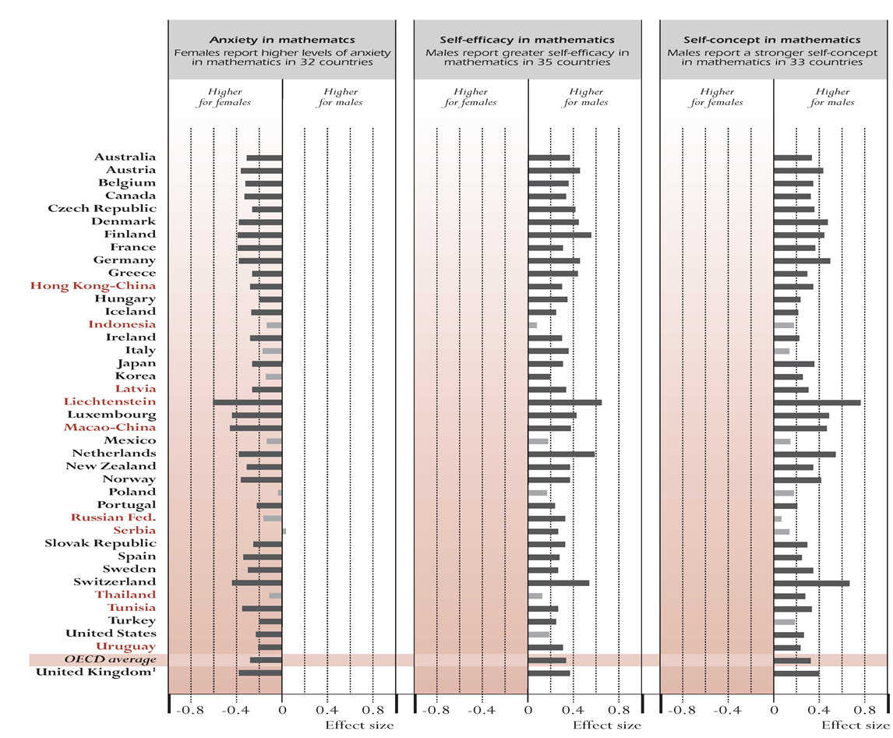
Affect and Gender Differences in Mathematics – OECD PISA 2003 Results

Slide 6
How to understand the role of affect in learning processes?

Slide 7
Affect and Learning
SELF-BELIEFS
Beliefs about own mathematical ability
Self-efficacy and control beliefs
Self-esteem, self-confidence
MATHEMATICAL BELIEFS
EMOTIONS
- Enjoyment, enthusiasm
- Anxiety, fear of failure
ATTITUDES
- Positive vs. Negative
MOTIVATION
- Interest, Personal learning goals
Persistence, Self-Regulatory activity
Metacognitive strategies
Learning strategies
Choices Performances

Slide 8
Developing a bit further…
Acknowledging:
The crucial role of self-perceptions in affect, learning and performances
The role of self-regulatory activity in learning and performances
Stable personal systems vs. Situational activation of these systems
d) Socio-cultural environment and math learning contexts
e) Previous results and models on affect and mathematics learning
Building on:
Theory on cognitive appraisals behind emotions
Theory on self-appraisals behind powerful affective arousals
c) Self-determination theory, agency
Social cognitive theories on self-efficacy and self-regulation
e) Humanistic perspectives on learning

Slide 9
A Learning Model – Self-system Processes
Socio-cultural and contextual features; Personality aspects
Self-systems
Interpretation and evaluation of self, events and experiences
Past events and experiences
Metacognitive, Cognitive and Affective sets; Behavioral patterns
Personal capacities & processes;
Self-states; Self-regulation
Learning situation
Performances;
Affective experience
New learning experience
Self-system processes
Contextual and socio-cultural environment

Slide 10
How to increase positive experiences and learning in classrooms?

Slide 11
Students’ Gains from Inquiry-Based Learning in Mathematics - Findings from a Follow-up Evaluation Project
Four US research universities included
IBL classes = Classes using a variety of active teaching and learning methods, designated “IBL” by each campus
Post-survey on self-reported learning gains:
How much did you gain… ? (Likert scale 1-5, no gain to great gain)
cognitive gains: math thinking, understanding concepts, application of math knowledge & gains in teaching
affective gains: confidence, positive attitude, persistence, independence
social gains in collaboration
Sample: 530 students in IBL math track classes
328 students in non-IBL math track classes

Slide 12
Included Studies of Student Outcomes
 | Math learning & thinking: external measures | Math learning & thinking: student self-report | Attitudes, Beliefs | Career & educational interests | Classroom processes
Math, S&E majors (intro & advanced) | Student work | Survey Interviews | Survey Interviews | Transcript analysis Interviews | Observation Interviews
Pre-service teachers | MKT measure | Survey Interviews | Survey Interviews | Interviews | Observation Interviews
- Augmented by interviews with instructors & TAs

Slide 13
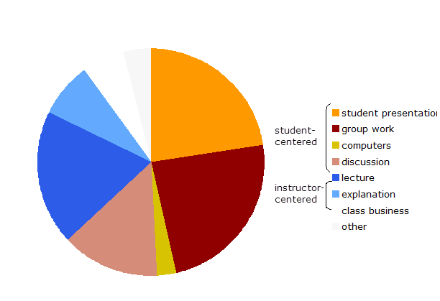
IBL:
~65% student-centered activity
Non-IBL:
~86% instructor-centered activity

Slide 14
Differences in affective & social gains
IBL men: N=351-355; Non-IBL men: N=227-229. IBL women: N=181-184;
Non-IBL women: N=88-90 Scale from 1 = no gain to 5 = great gain.

Slide 15
Learning gains reported by students - Open-ended responses from the survey
13-38% (IBL) and 12-20% (Non-IBL) of students wrote % = Per number of surveys
GAINS | IBL | Non-IBL
Learning and understanding math CONCEPTS and IDEAS | 168 (19%) | 57 (10%)
THINKING and PROBLEM SOLVING SKILLS | 121 (14%) | 41 (7%)
Changes in ways of LEARNING MATH and SOLVING PROBLEMS | 91 (10%) | 33 (6%)
INDEPENDENCE in learning and solving | 82 (9%) | 16 (3%)
COMMUNICATION skills | 85 (10%) | 10 (2%)
CONFIDENCE in own math ability and skills | 31 (4%) | 5 (1%)
ENJOYMENT of math and learning | 22 (3%) | 2 (0.3%)

Slide 16
Learning gains & Observed classroom practices
Averages for upper 25% percentiles (high) of each activity in IBL classes

Slide 17
Observed social atmosphere - Four different IBL classes
“To what extent did students….?”
Scale from 1 = never … to 5 = very often

Slide 18
Reported learning gains - The same four IBL classes
Scale from 1 = no gain … to 5 = great gain

Slide 19
Student descriptions of the processes
F: It also makes you like it more as well. You know, it’s a lot more fun to really understand something. And you can put more pride in your work and stuff.
F: I mean, I’m sure that in other math classes that I took, I could have figured out a lot of the things for myself, but it was just easier to listen. But… maybe I never really knew that I could do it by myself, but now I do….
M: …. Just, this does make it easier to get up in front of someone, show them what you did and feel more comfortable in defending on what you did, compared to someone who didn’t take this class.

Slide 20
Student descriptions ……
F: Maybe just the fact that a lot of times, if I come across a hard problem, I would think, ‘Okay, I just don’t really care if I learn this or not.’ And now it’s more like, ‘I can come back to it later.’ I’ve learned to cope with my frustrations more, I guess.
M: …It’s never really boring to do it this way, there’s always something new to do, and it’s not very repetitive at all. Like, even though the class general format is the same every time, there’re always different theorems. And it seems like we move pretty quickly… we don’t get stuck for too long, because the whole class is working together.
M: … There’s just kind of this collective thing that kind of builds in the IBL course. You feel like you’re part of something… when we’re all putting our efforts towards this problem.

Slide 21
Concluding Remarks
Students’ shared responsibility for setting the course pace and direction made a measurable difference in the strength of students learning gains.
The important roles of both collaborative and individual work in students’ engagement and learning processes:
- Challenging and meaningful problem-solving and collaborative work fostered students’ learning and positive experiences
Interactive and collaborative course experiences seemed to eliminate discouraging experiences that may impede learning in lecture-based courses for women and first-year students.
→ Taylor, 1998: ‘ horizontal student-teacher relationship’
→ Cummins, 2000: ‘collaborative power relations’
→ Nasir, 2002; Wenger, 1998: students’ identity, goals, and learning transformed by participating in a more open and active social learning environment

Slide 22
Better approaches to mathematics learning will not only emphasize immediate and easily measurable cognitive outcomes, but will also consider learning situations as important occasions for meaningful engagement and personal cognitive, affective and social growth.

Slide 23
Important issues to be considered
How can institutional culture and practices enhance students positive experiences and learning?
What kind of curriculum, materials and activities help students build positive relations to the subject and to their own and others’ learning?
How can instructors reduce negative affect & increase positive affect in their daily classrooms?
What can other students do to reduce their peers’ negative affect and increase others’ positive learning experiences?

Slide 24
A few references:
- Educational Studies in Mathematics, 2006, No. 63. Special Issue on Affect.
- Malmivuori (Hassi). (2001). The dynamics of affect, cognition, and social environment in the regulation of personal learning processes: The case of mathematics. Research report 172. Helsinki, Finland: Helsinki University Press.
http://ethesis.helsinki.fi/julkaisut/kas/kasva/vk/malmivuori/
- Malmivuori (Hassi), M. L. (2008). Understanding student affect in learning mathematics. In: C.L. Petroselli (Ed.), Science Education Issues and Developments, pp. 125-149. Nova Science Publishers, Inc.
- Laursen, S., Hassi, M.-L., Kogan, M., Hunter, A.-B., & Weston, T. (2011). Evaluation of the IBL Mathematics Project: Student and Instructor Outcomes of Inquiry-Based Learning in College Mathematics. Boulder, CO: University of Colorado, Ethnography & Evaluation Research. http://www.colorado.edu/eer/research/steminquiry.html
Thanks to The Educational Advancement Foundation (EAF), - Sponsor of the IBL Evaluation Project

