Slide 1

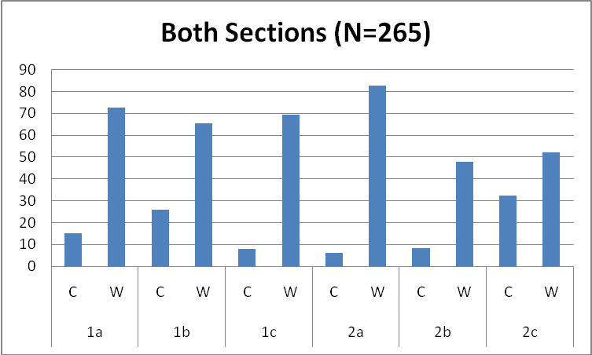
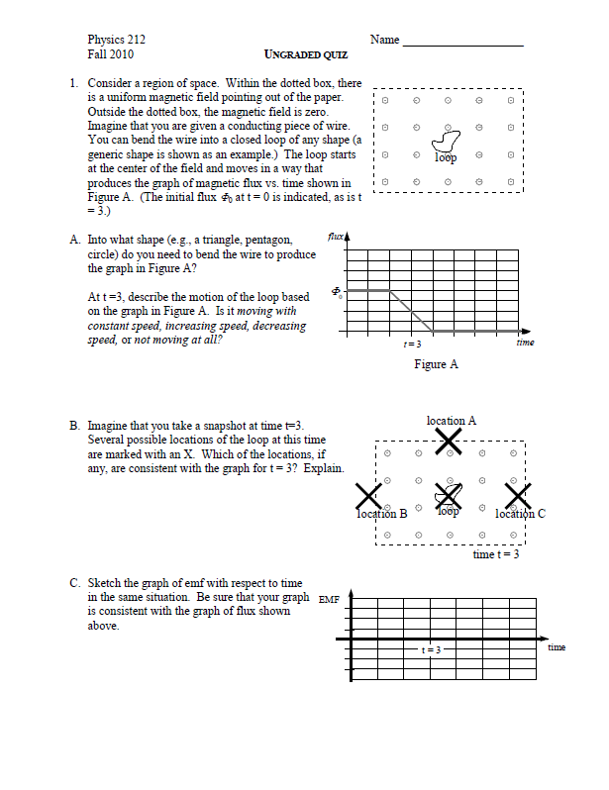
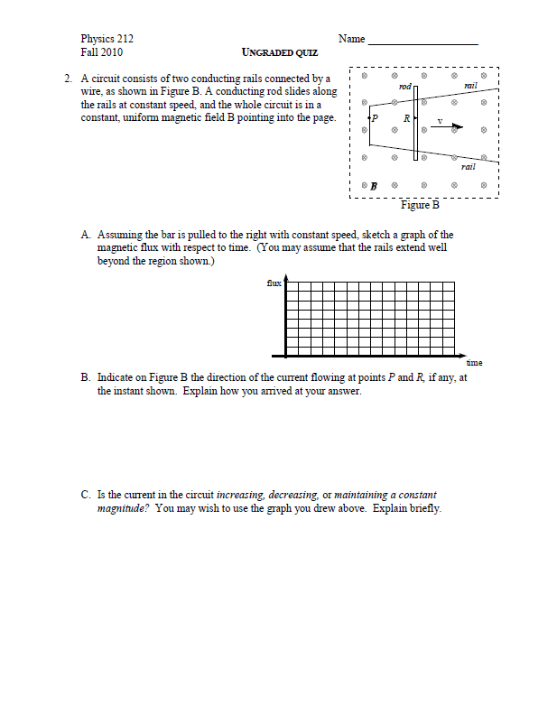
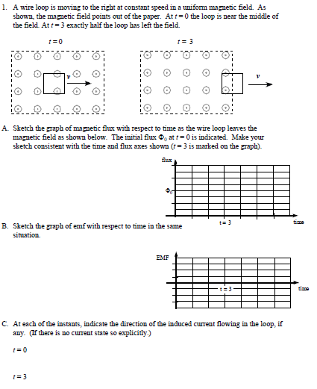
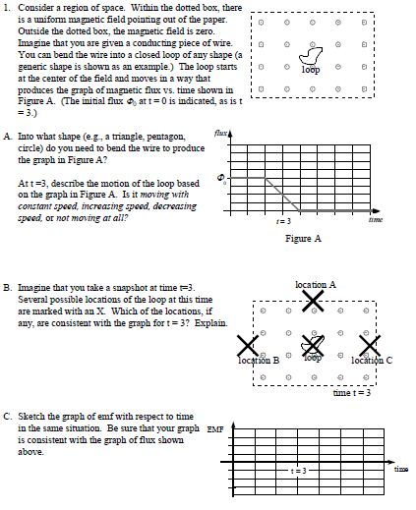
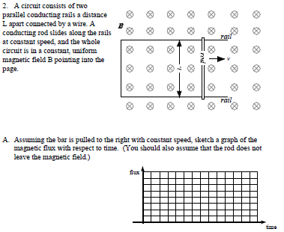
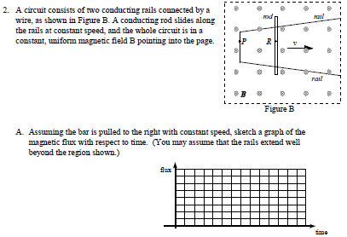
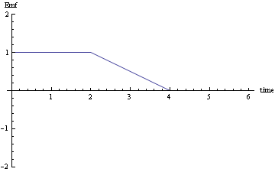
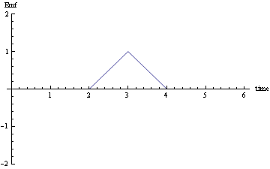
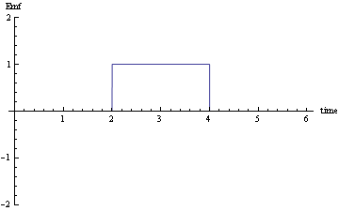
Further Investigation of Examining Students’ Understanding of
Lenz’s Law and Faraday’s Law
Casey Sanchez and Michael E. Loverude
Department of Physics, California State University Fullerton
Introduction/Background
Results/Discussion
Instructional Survey
Instrument
Overall Results
Our goal of this study is to develop an instrument that can be used by instructors in understanding the difficulties students face when trying to comprehend the key aspects of Faraday’s Law and Lenz’s Law
Revision of Instrument
A summary of the percentage correct (C) and incorrect (W) responses to each question is shown in the figure to the right. Both sections showed similar trends overall.
(Note that blank or unclassifiable responses are not shown so columns do not add to 100%)
In previous research, we found that when students were asked to draw flux and EMF vs. time graphs, they tended to draw the same graph for both quantities. We revised the written problems in our previously constructed instrument in order to resolve some of the unanswered questions. In particular, we asked students to ‘reverse the reasoning’ [6] and modified several tasks in order to distinguish between potentially correct and incorrect responses.
Information that one can obtained:
How students see flux as a function of time
How students understand the relationship between electromotive force (emf) and the change in magnetic flux
What students understand about the direction of induced current
Individual Results/Common Response Patterns:
In part 1a: Construct a shape that would best correspond to the flux vs. time graph given and describe the motion of that loop at a given instant (t=3)
Students responded that the loop should be a circle or triangle
In responses about the motion of the loop, students tended to relate velocity of the loop directly to the flux vs. time graph
  Most of the students answered that the speed would be constant (37% for CB and 28% for AB) or that it would be decreasing (40% for CB and 47% for AB)
In part 1c: Construct a graph of EMF vs. time given the flux vs. time graph
The most common incorrect answer (about 26% for CB and 30% for AB) was to draw a graph very similar to the flux vs. time graph
In part 2a: Construct a flux vs. time graph given a physical situation
Students (38% for CB and 39% for AB) drew straight lines and stated that velocity was constant to support their reasoning.
In part 2c: Determine the amount of the current flowing given a physical situation
Students predicted that the current would be constant (about 34% for CB and 30% for AB), with many explicitly relating speed to current.
Past Results from Pervious Research:
We found that students had difficultly with:
Understanding the difference between flux and change of flux
Visualizing how magnetic flux changes given a certain physical situation
Using the right hand rule (RHR) given a certain physical situation
Motivation for Graphical Representation:
Graphs in general contain large amounts of data that can be inferred for analysis when it comes to trying to understand a certain physical situation [1,2]
Likewise, requiring the students to draw graphs provides insightful information regarding how students understand flux as a function of time
The derivative relationship between flux and EMF is reminiscent of the relationship between kinematic quantities, for which graphical representations have become an important instructional mode
Here we changed the instrument to address some student responses that suggested a preferential association between flux and velocity regardless of the physical situation.
Conclusion
Method
Although most of the students did not perform well in the survey, we believe there is value in the graphical representations of flux vs. time and EMF vs. time. Our discussions with students during and after the interviews in particular support our belief. In the interviews, several of the students indicated that the graphical representation was useful to them in helping to visualize these quantities and their relationships. Most of the students also brought up their previous experience with similar representations from kinematics.
The representation seems to have value as a research task, but we further feel that it is a potentially valuable instructional tool. Our results as well as those from previous research suggest that many students develop very little in the way of intuition or conceptual understanding of these ideas. It seems reasonable to call upon the experience students have with kinematics graphs, and use a graphical representation to supplement symbolic and verbal ones, in order to improve student understanding of this topic. Some caution is necessary, however, as our results do suggest that students struggle with some of the same issues with these graphs as they do with kinematics graphs.
Context for Research:
Our study sample consisted of two different levels of introductory physics courses at California State University Fullerton:
Physics 212: algebra-based (AB)
Physics 226: calculus-based (CB)
Our sample includes three sections of each course, with N=130 and 135 students, respectively
Survey Instrument:
Consists of altered textbook problems regarding magnetic flux designed to be more conceptual than quantitative [3,4,5]
Constructed as an overall evaluation of the students’ understanding and appropriate for both AB and CB courses
Given after classroom instruction
  Time allowed to complete the survey is 15 minutes
The written instrument was also used as the basis of a multiple choice online version (not reported here) and for several (N=5) individual student interviews with volunteers selected from the two courses
Data Analysis:
Coded all graphical responses for future reference
Summarized students’ explanations/answers and entered them into a Microsoft Excel spread sheet
Interview Responses
(1)
Further Motivation for Graphical Representation:
(1) The student initially stated that “emf is a function of flux over time.” She then drew the same graph as the flux vs. time given.
(2) She then stated before we asked her to explain why she choose her answer that “it is kind of an abstract concept to me”. As she explains her reasoning, she restates that “emf is the change in flux” and that “if we are talking about change in flux, it is not just flux, as a function, it is not flux over time, it is change of flux over time.”
(3) Though she was convinced about the beginning and ending line segments of the emf vs. time graph, she was still not comfortable with the correct center line segment that she then drew. She stated that the middle segment “may not be correct.”
(2)
(3)
References:
[1] Leith D. Allen, “An investigation into student understanding of magnetic induction,” Ph. D. dissertation, Ohio State University, 2001
[2] R. F. Beichner, “Testing student interpretation of kinematic graphs,” Am. J. Phys. 62, 750-762 (1987)
[3] Wolfson, R, & Pasachoff, J. M. (1987). Physics Volume 2. Canada: Little, Brown and Company
[4] Maloney, et al., (2001). Surveying students' conceptual knowledge of electricity and magnetism. Phys. Educ. Res., Am. J. Phys. Suppl., 69, 12-23.
[5] Scaife, T. M., & Heckler, A .F. (2007). The effect of field representation on student responses to magnetic force questions. 2007 Physics Education Research Conference
[6] A. B. Arons, “Student patterns of thinking and reasoning,” Physics Teacher 22 (1984)
Note: The given flux vs. time graph gave the student a chance to correct her incorrect answer as well as confirm her reasoning. “This challenge’s me into actually thinking about it as a function, not just plug and chug with numbers”
Supported in part by CSUF Louise Stokes Alliance for Minority Participation grant, NSF HRD- 0802628 and the McNair Scholars Program

