Slide 1
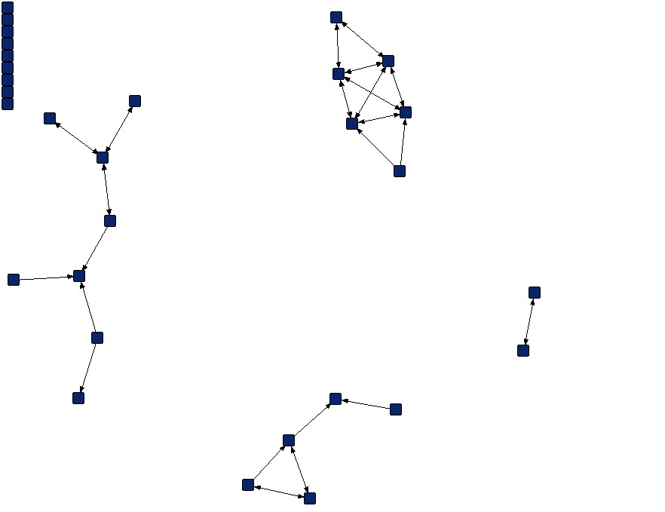
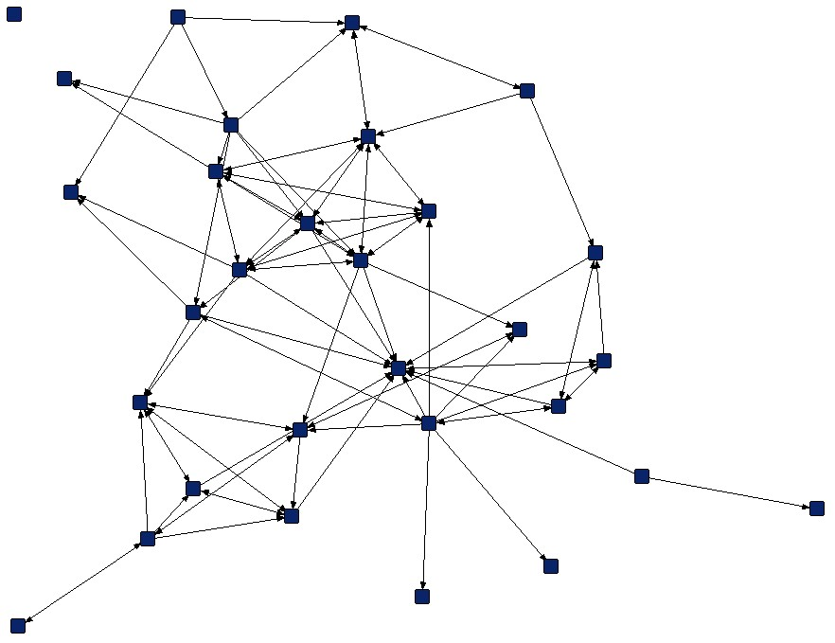
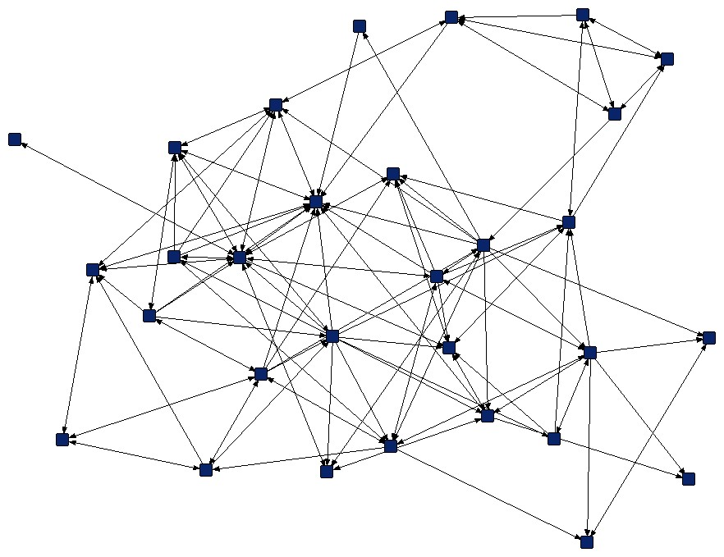
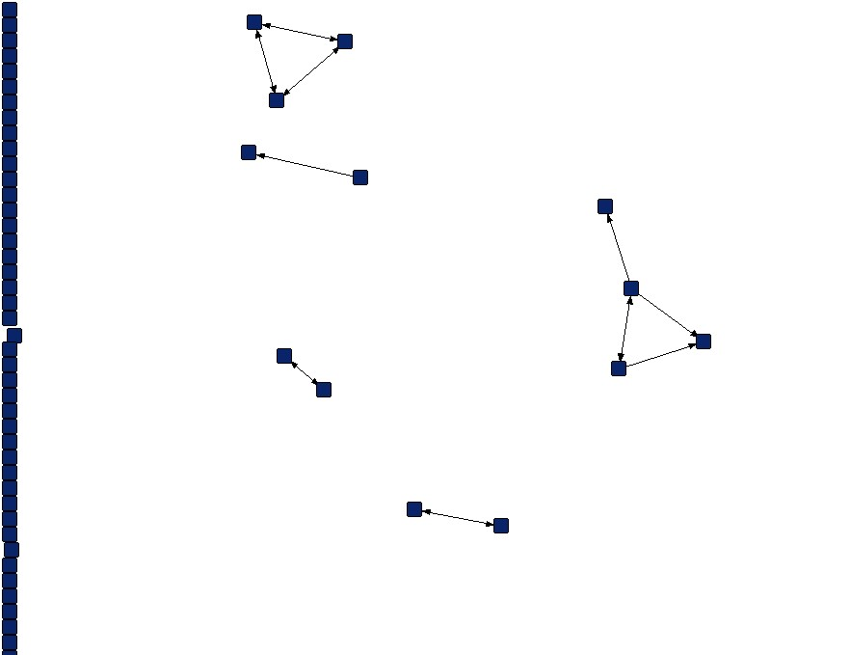
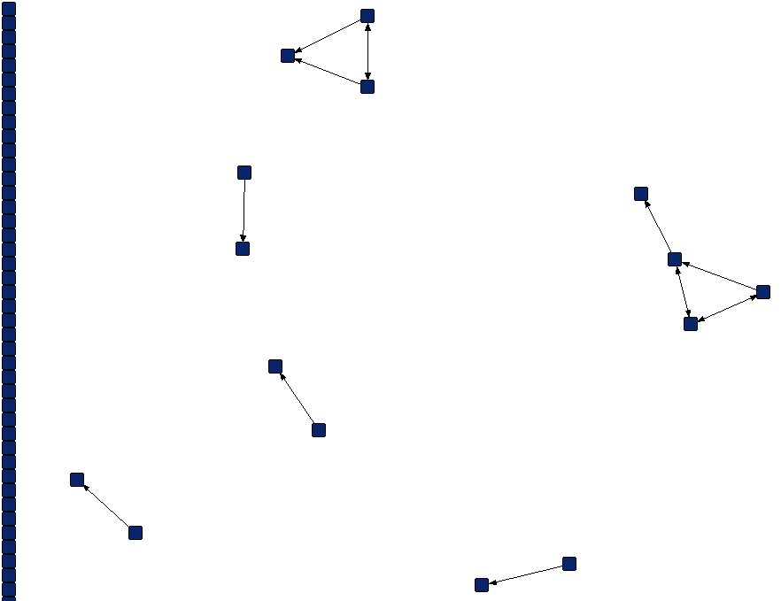


Changing Participation Through Formation of Student Learning Communities
Eric Brewe, Laird H. Kramer, George E. O’Brien
Florida International University
Node = student
Increasing density indicates changing participation
Isolate = unconnected student
Modeling Pre
Modeling Mid
Modeling Post
d = 0.0425
d = 0.1126
d = 0.1529
Tie = collaboration
Environment influences expectations about participation
Lecture Pre
Lecture Post
d = 0.0025
d = 0.0022
Formation of Learning communities serves as proxy for epistemological foundation of instructional environment. Engaging students brings them into a learning community.
NSF AWARD 0802184

